Slide 1
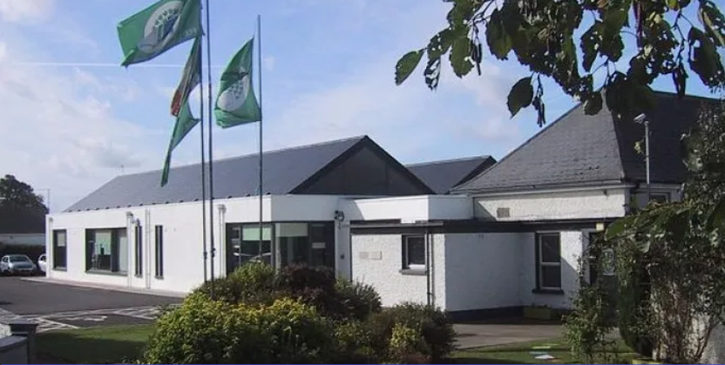
Scoil Mhuire, Robinstown Co. Meath
Parent/Guardian Information PowerPoint 28th May 2024

Slide 2
Dear Parents/Guardians,
A very warm welcome to Robinstown N.S. we hope that your child will be extremely happy here.
Our school is a happy and safe place where every child matters. Without your support we cannot succeed so we look forward to working in partnership with you in the interest of your child’s all round learning and personal development.
We have a wonderful staff and you can be assured of our full co-operation and commitment at all times.

Slide 3
School Community.
Board of Management (Chairperson, Principal, 2 Parents, 3 community members and 1 Staff Rep)
Staff (Principal, 7 class teachers, 3 L.S. Teachers, Secretary, 6 S.N.A’s, Caretaker and Cleaners)
167 Pupils (ASD & Junior Infants – Sixth Class)
Parent Association

Slide 4
General Information.
School Hours are 8.50am – 12pm for the first two weeks of school and 8.50 am – 1.30 pm subsequently.
Break times 11.00am – 11.10am (first break) and 12.30pm - 1pm (lunch break)
Booklists are in the pack.
School uniform consists of a school tracksuit with runners.
Please inform the school of any hearing, sight, asthma,
allergies or other medical issues.
School policies including Healthy Eating, Child Protection Policy and Anti Bullying are available to be viewed on the school website . www.robinstownns.com

Slide 5
Communication
We believe in open lines of communication. This is done in various ways.
Parent teacher meetings.
School Website www.robinstownns.com
Facebook page – Robinstown NS
Monthly Newsletters
Databiz App/Text a Parent
Parent’s Association Whats App

Slide 6

DataBiz Eolas App
We now communicate through our app, ‘DataBiz Eolas’, e.g. newsletters, absences, school announcements, payments etc.
This can be downloaded from the Google Play and Apple app stores.

Slide 7
Punctuality and Attendance
Good attendance and punctuality are vital.
Supervision in the yard begins from 8.40am.
There is a Drop and Go system in place.
Your child will be greeted by a 6th Class child who escorts them the yard.
Feedback on this has been hugely positive for you as parents and the children.
The school is legally obliged to report children who have missed more than 20 days to the National Education Welfare Board.

Slide 8
Extra Curricular Activities.
Buddy System
Christmas Plays / Concert
Maths Week / Science Week
ICT: 30 Chromebooks and 35 Tablets
Grandparents’ Day, Friendship Week, Well –being Week and St. Brigid’s Day Cross making
Credit Union Quiz Competition
Tráth na gCeist
National Spelling Bee
Seachtain na Gaeilge and Lá Glás
School Tours and Field Trips
Swimming in Kells Swimming Pool (resumed this year for all children from senior infants to 6th Class)
5 Green School Flags and School Garden (Pride of Place)
Active School Flag, Active Schools’ Week and Sports Day
Healthy Eating Committee
First Confession and Holy Communion (2nd class)
Confirmation (6th class)
Internal school hurling ,football (fundamentals Junior Infants – 2nd and 3rd – 6th participated in the GAA All Star Programme)
Inter school gaelic football, hurling, camogie, olympic handball, basketball, rounder's and soccer competitions.
Choir Teacher (Lisa Rooney)
Music teacher
School library
European Language Teacher (New Curriculum)

Slide 9


Green Schools Programme – Flags to date
Litter and Waste
Energy
Water
Travel
Biodiversity

Slide 10

Little Acorns
Our Early Intervention pre-school class caters for children aged 3 to 5 and offers the interventions they require before they begin school.

Slide 11
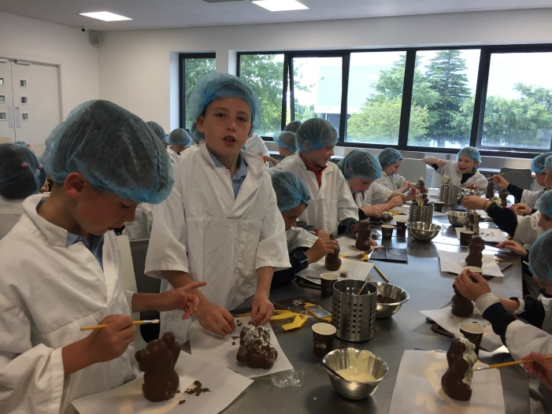
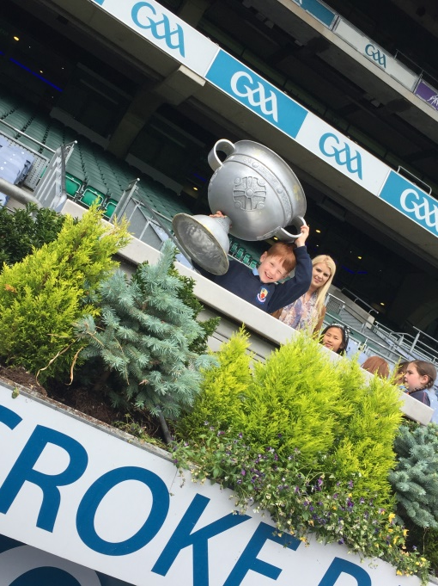
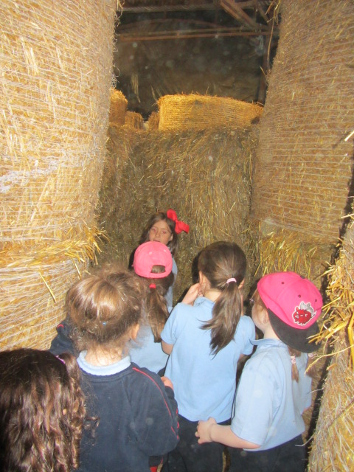
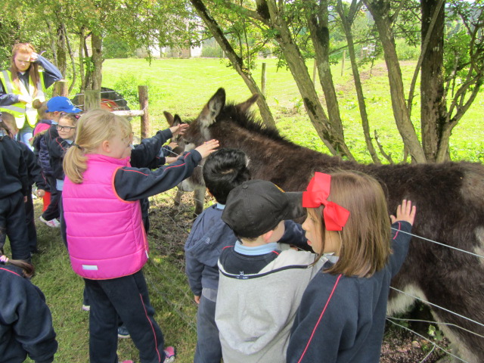
School Tours
- Educational tours: Library / Solstice / Museums / Historical Sites / places of interest.

Slide 12

IT
We have access to 30 chromebooks and 35 tablets in Robinstown NS. These are timetabled for all classes.
We follow an IT framework:
e.g. 1st class – start a programme, work on text and pictures.
3rd Will focus on typing using the BBC dance mat typing programme.
4th Class will work on files and folders and how to organise and save work. Focus will also be on typing using the TTRS typing programme.
6th Class will work on how to develop their own website.
Digital learning is an integral part of the new curriculum which will be implemented in 2025

Slide 13
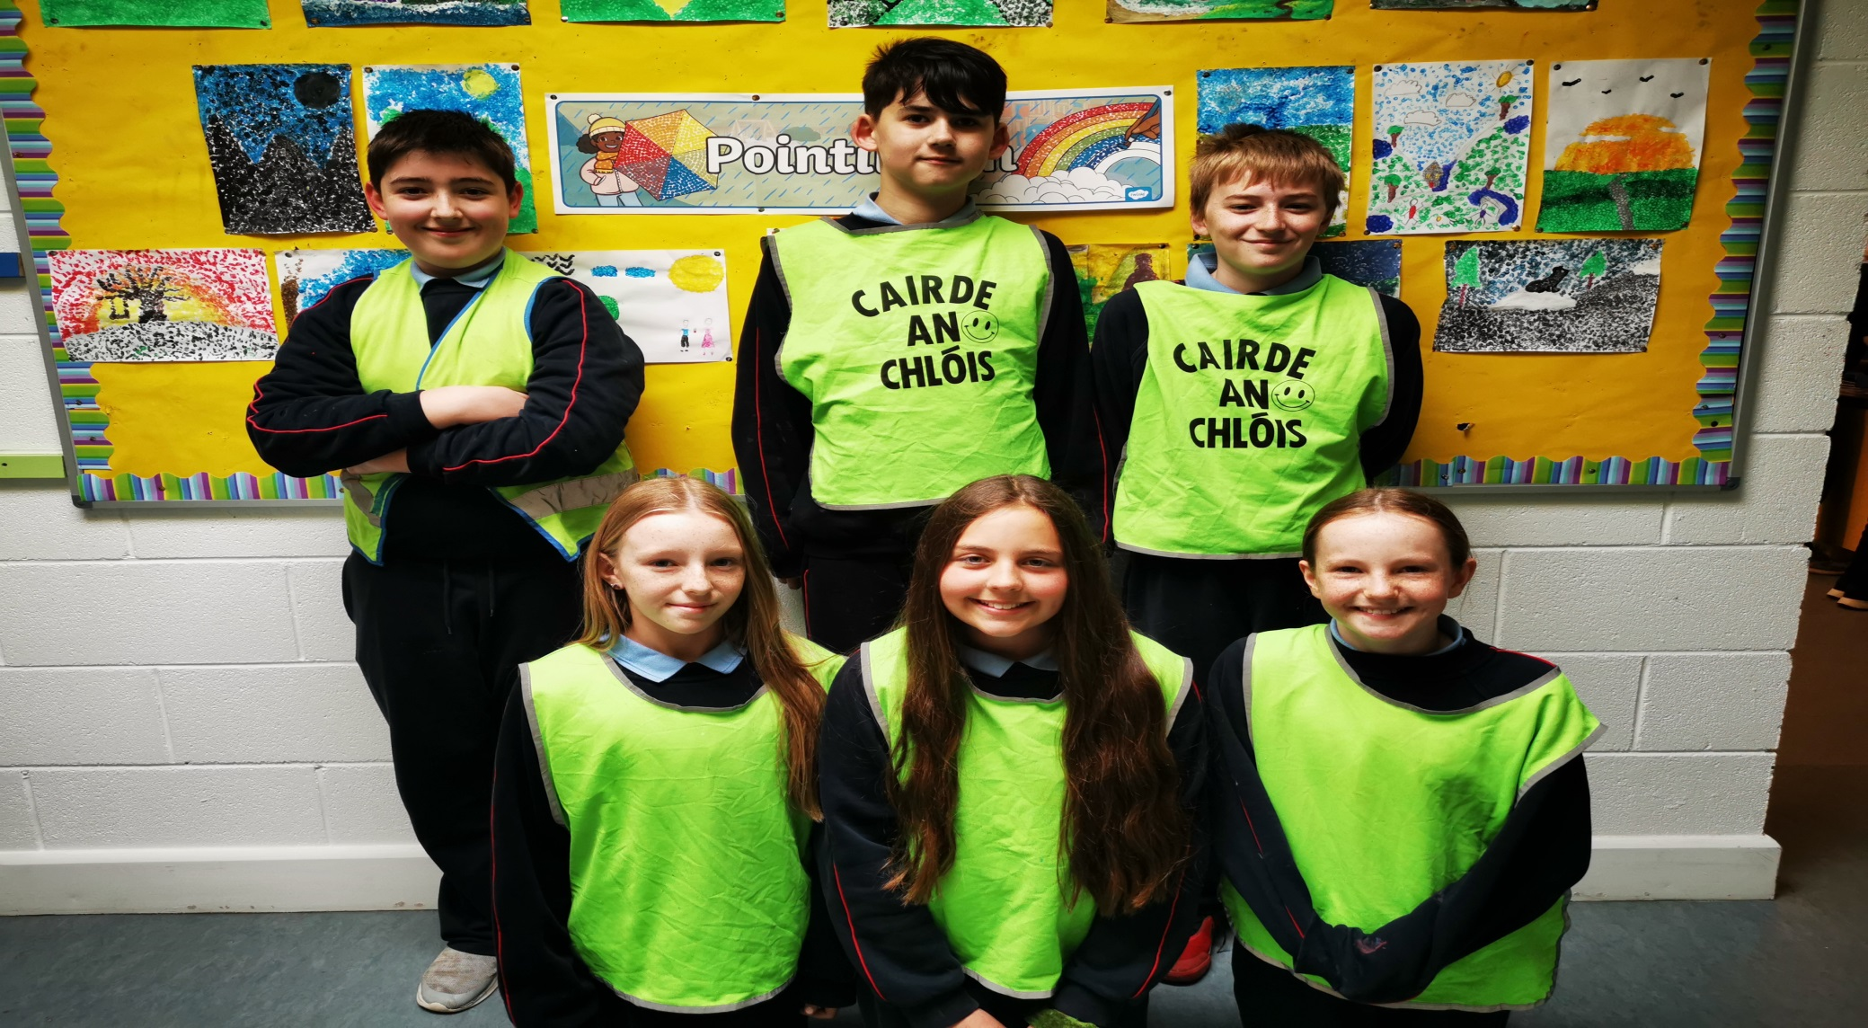
Cairde an Chlóis

Slide 14
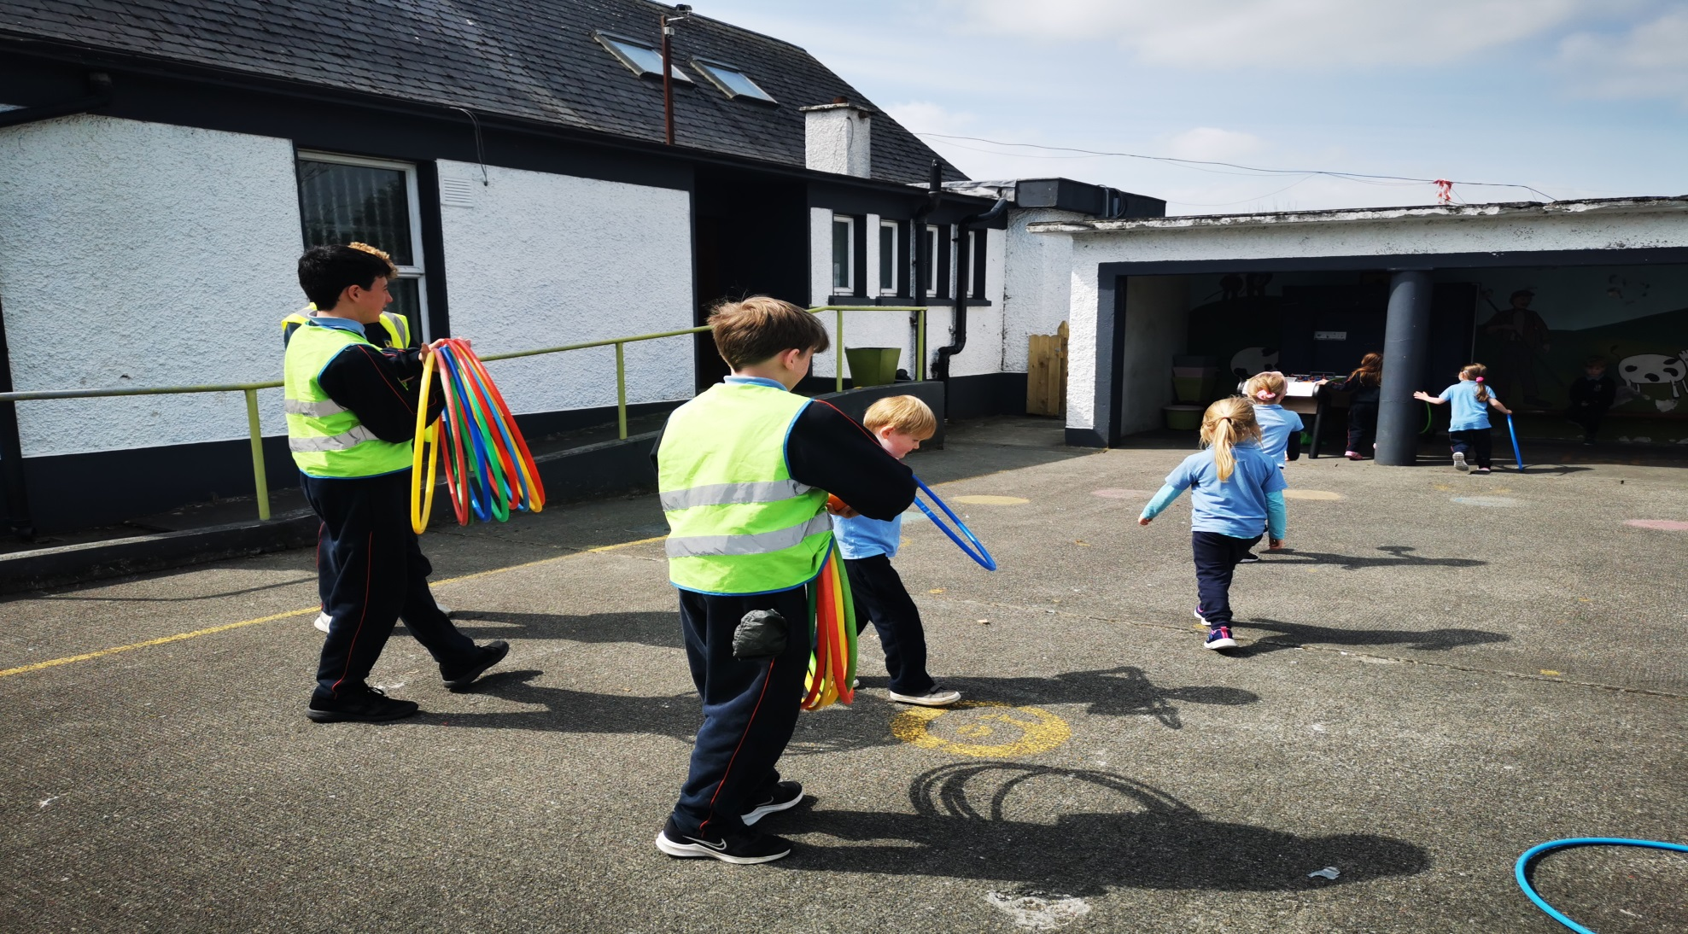
Cairde an Chlóis

Slide 15
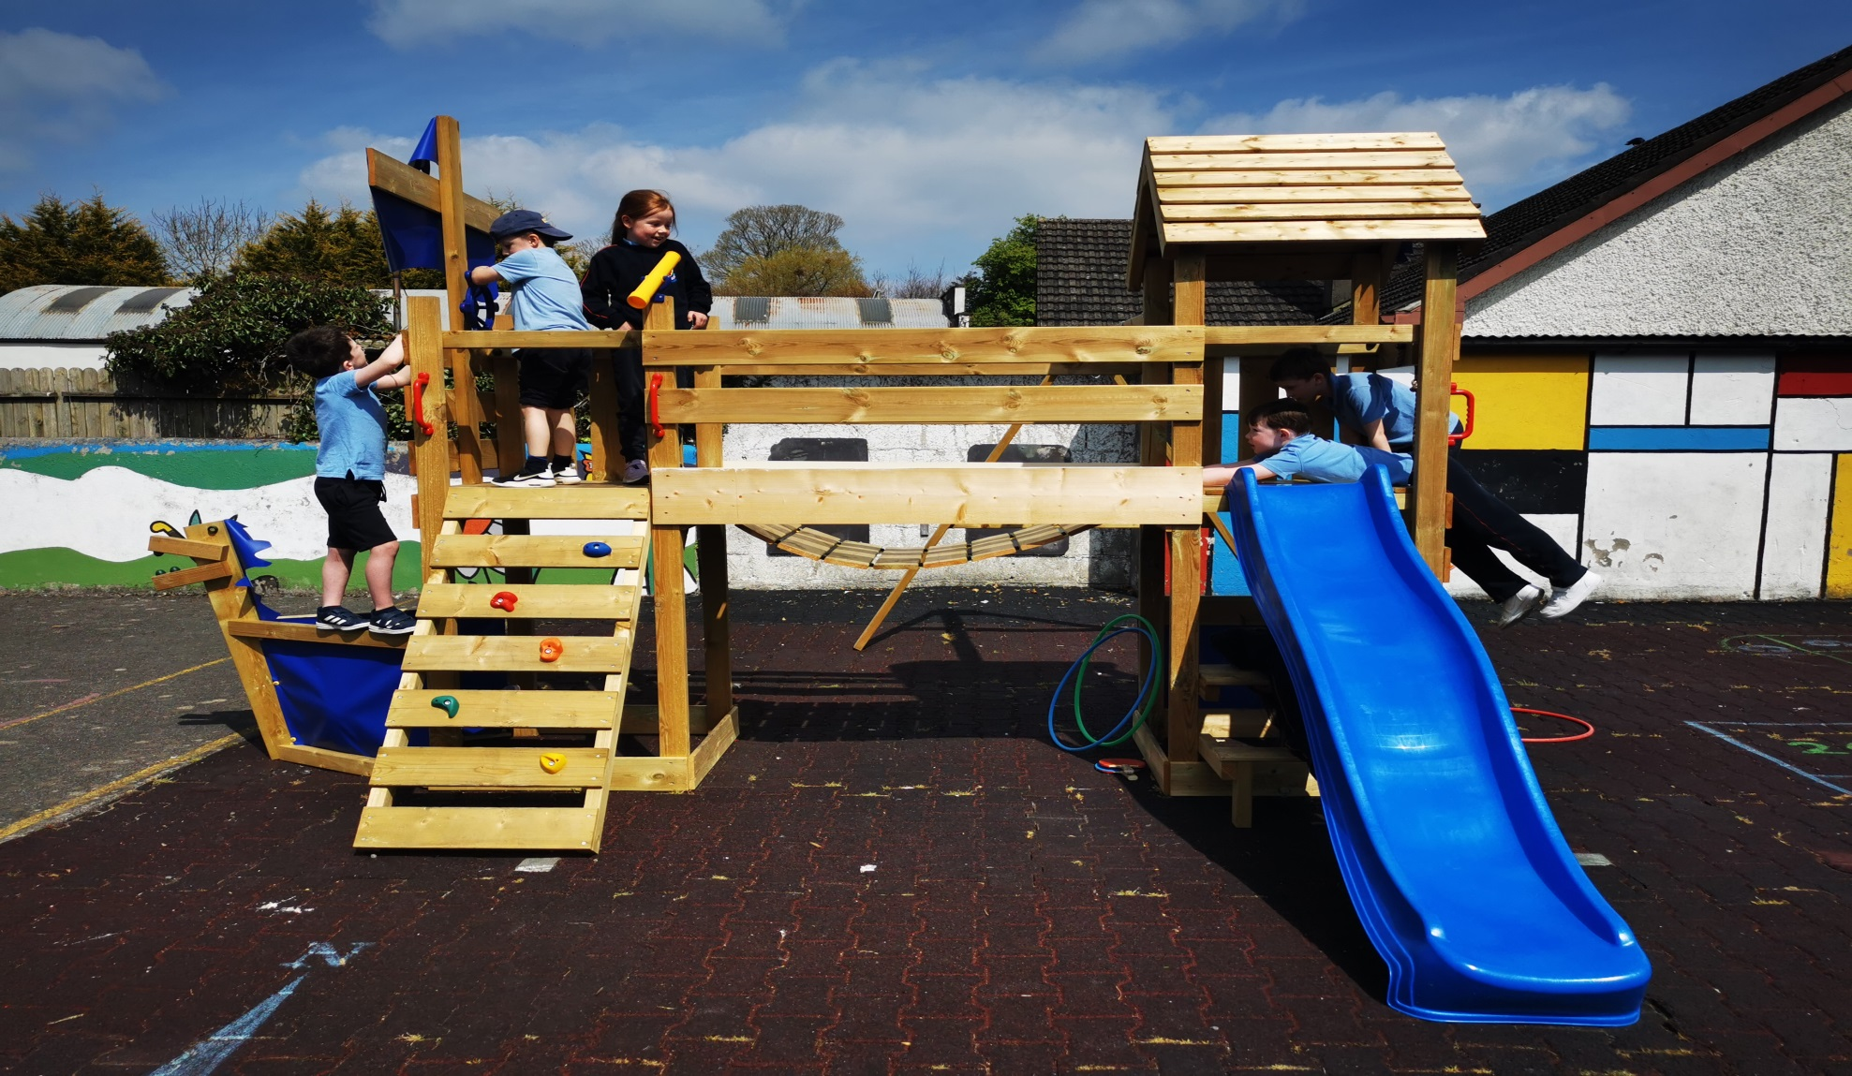
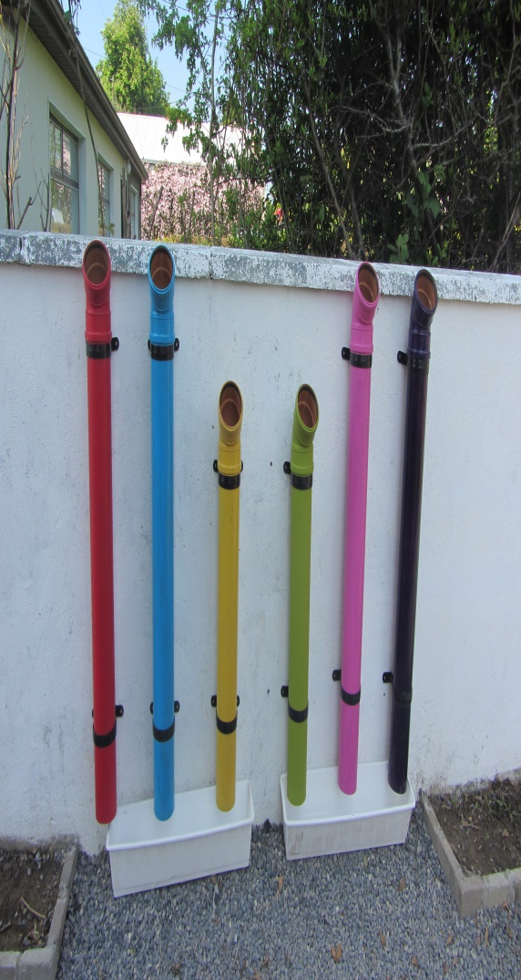
Infant Yard

Slide 16
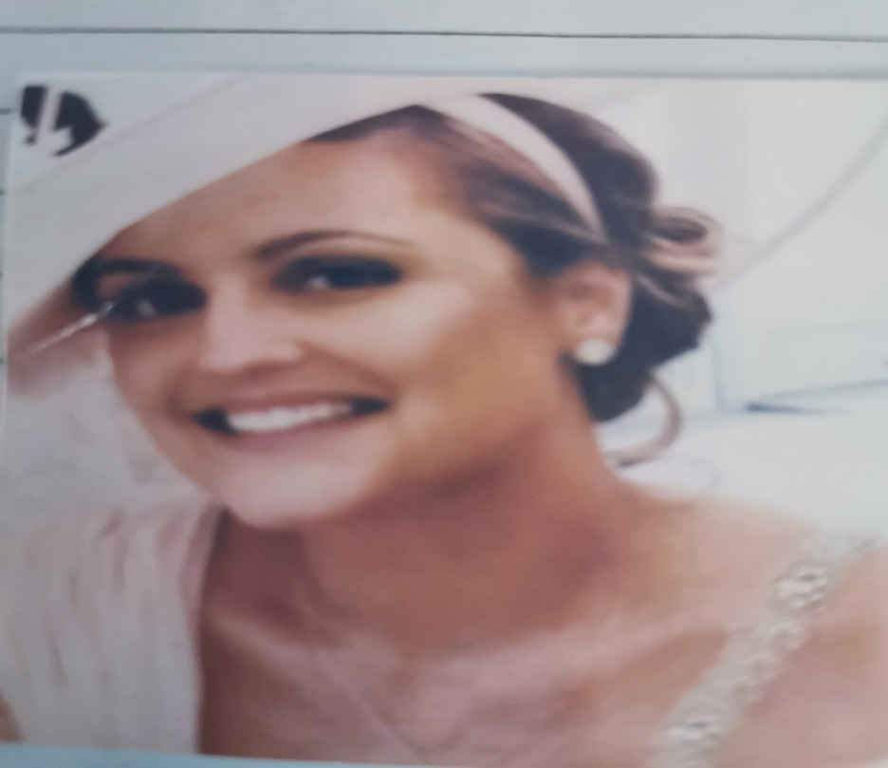
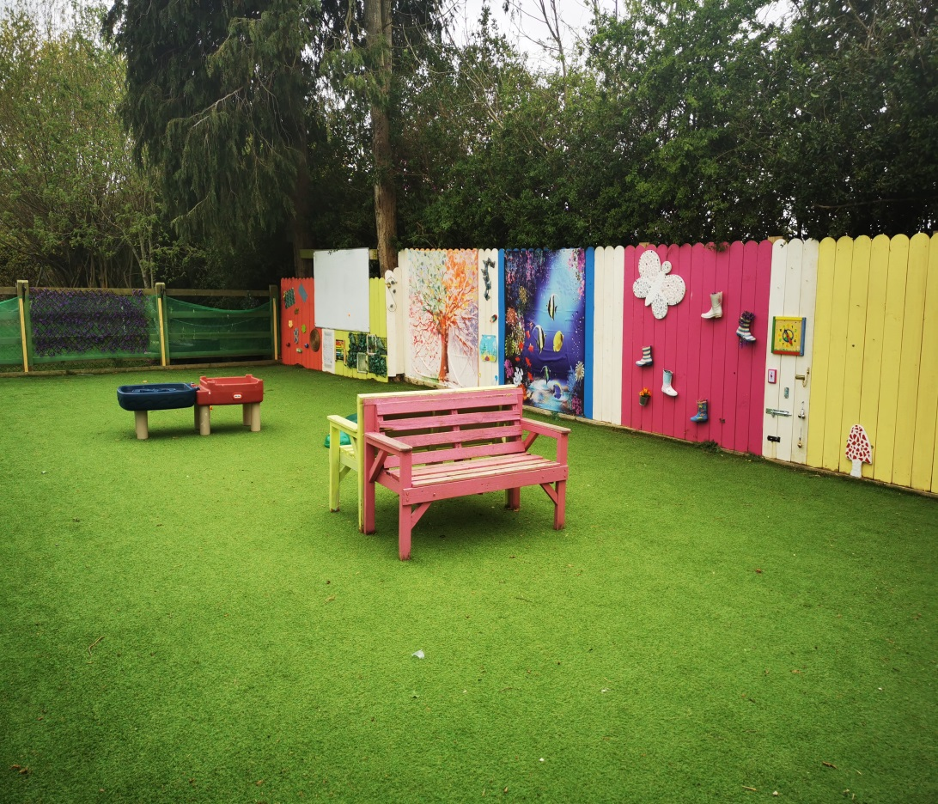
Ms. Brady’s Outdoor Classroom / Sensory Garden
Ms. Brady was a member of our teaching staff who sadly passed away in 2016. This part of our school garden was opened in her memory. Little Acorns use it at break times and all other classes have access during the school day.

Slide 17
Before Your Child Starts
The independence of your child is crucial in making the transition to school as smooth and enjoyable as possible
Button / Zip a coat and hang it up.
Close and open the velcro on their runners.
Ensure they can manage their lunch independently.
Encourage personal hygiene and cleanliness. Your child should know how to flush the toilet and wash hands , without having to be told.
Share toys and playthings with others and ‘take turns.’
Tidy up and put away playthings.

Slide 18
First Day At School.
For the first two weeks the Junior Infants will start at 8.50am and finish at 12 o’clock.
For the first day bring your child into the classroom, they will be welcomed and shown to their seat.
Having given assurance you will be back to collect him/her, wave goodbye and make your getaway without delay.
Rest assured, they will be in great hands when you leave. These early days are short.
The children will be brought to the front door at home time. Please wait at the front pedestrian gate for the class to come out.
From Day 2 you will bring your child to the Junior Infant line in the yard. The teacher will bring the class in from here.

Slide 19

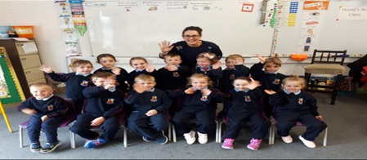
First Day at School
In spite of the best efforts of both teacher and parents/guardians a small number of children may still become upset. If your child happens to be one of them don’t panic. From years of experience, they are totally fine when you are gone.

Slide 20
Do.......................................
Label everything, including all your child’s uniform and tracksuit with a permanent pen/marker.
Give your child jobs to do at home and build them up over time.
Buy big school bags with no wheels and make sure they are large enough to hold A4 folders.
Drinks bottles and lunch boxes that are sturdy but easy to open.
Buy runners with velcro.
They should have a coat that they can easily manage.
Give out birthday invitations at the school gate.
Please remember, we are a nut-free school so no chocolate spread or nut contents in any school lunches.
Ensure your child knows to ask teacher to go to the toilet.

Slide 21
School Books
All school books, activity books and copies will be provided by the school for Sept 2024.
This will lessen the costs for parents as their child begins their journey through primary school.
It will also reduce stress levels for parents and children as they will not have to worry about whether they have all the right books.
There is a small list of supplementary items to be purchased for September. This list is in your pack.

Slide 22


Healthy Eating
We promote healthy eating in Robinstown NS.
Research indicates a strong link between diet and performance in school.
Lunch is an important meal for school going children, so we encourage all parents to put thought and care into preparing lunches.
Please see school website for our Healthy Eating Policy. These guidelines were drawn up by school staff, parents and pupils of Robinstown NS.

Slide 23
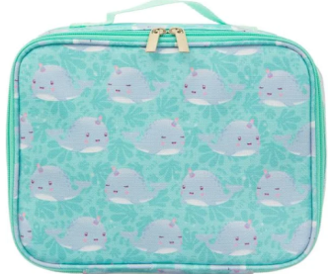

Lunches
Children get time to eat their lunch before they go on yard (approximately 10 minutes)
Give them enough food they can manage (Practice at home)
Drinks container they can open and close themselves.
Zip lunch bags work best
They must be able to recognise their own lunch box and container
Optional: The Lunch Bag deliver lunch to the school each day through their app. Parents can register and choose items for their child’s lunch.
Please do not send yoghurts.
Please note that we are a NUT FREE school.

Slide 24

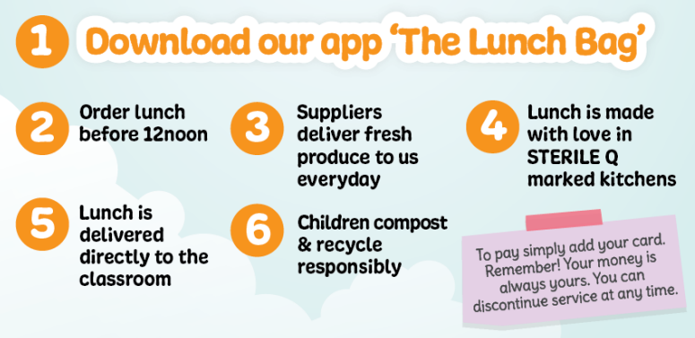
The Lunch Bag

Slide 25

Homework
When homework begins, your child will be sent home with a Homework Folder.
This will include a homework sheet with all homework mapped out for the week.
It will reinforce what your child learns at school, sounds etc.
It is so beneficial in this first year to complete this homework with your child.
Communication notes may also be in
this folder.

Slide 26

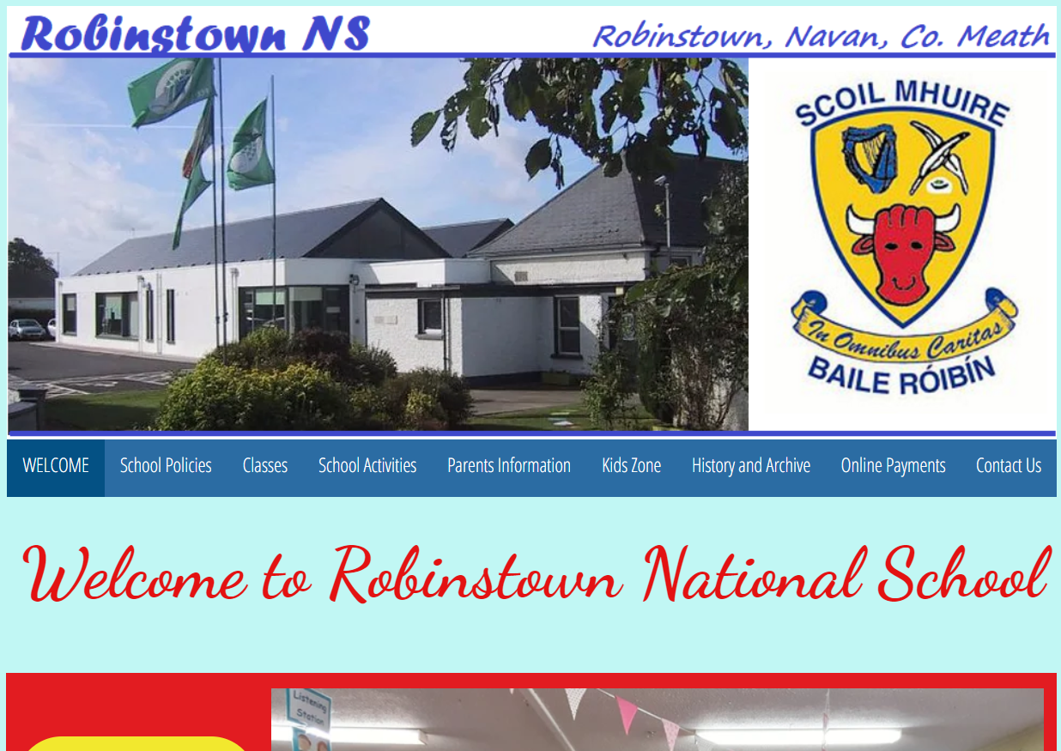
Please see our school website for more information and tips for parents.
https://www.robinstownns.com

Slide 27

Little Robins
Our local childcare facility was opened in January 2017. It opens daily from 8am. Children attending after school care in Little Robins are collected at school by member of Little Robins staff.
Services include:
Breakfast club
Pre school
After school, meals included in the cost
Part day care
Full day care
Guitar lessons (age 7)

Slide 28
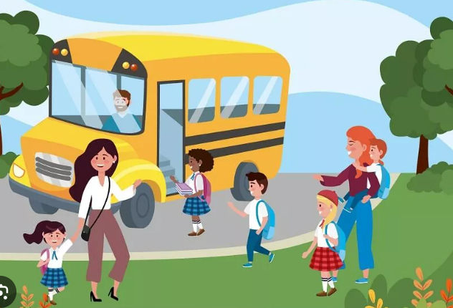
We look forward to welcoming the children to the school on
Wednesday 7th of June from 1pm – 2pm.
The pupils will play and socialise in the classroom, meet their new classmates and teacher. Parents will be offered refreshments and the opportunity to ask questions.

Slide 29
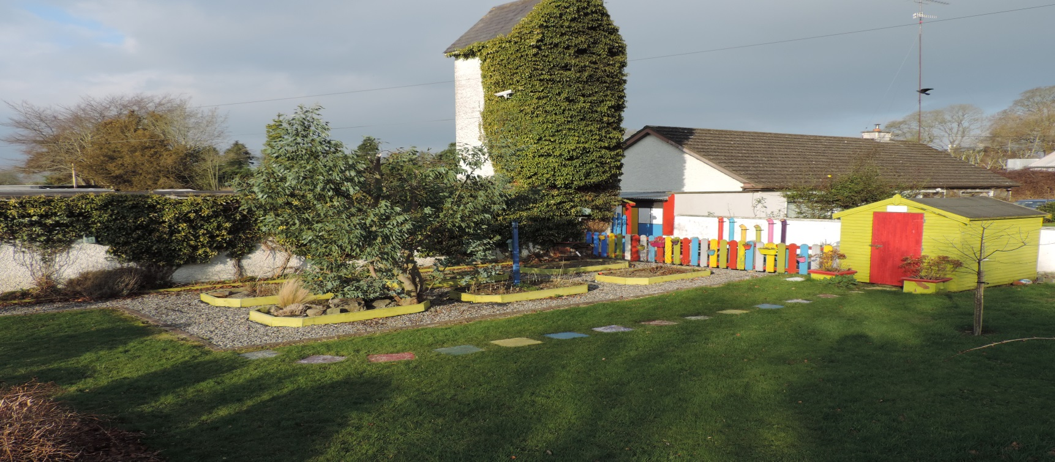
Thank you for coming

