Slide 1
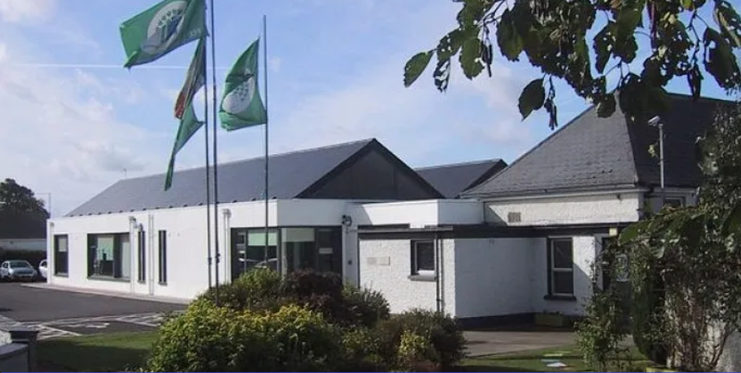
Scoil Mhuire, Robinstown Co. Meath
Parent/Guardian Information PowerPoint 10th May 2023

Slide 2
Dear Parents/Guardians,
A very warm welcome to Robinstown N.S. we hope that your child will be extremely happy here.
Our school is a happy and safe place where every child matters. Without your support we cannot succeed so we look forward to working in partnership with you in the interest of your child’s all round learning and personal development.
We have a wonderful staff and you can be assured of our full co-operation and commitment at all times.

Slide 3
School Community.
Board of Management (Chairperson, Principal, 2 Parents, 3 community members and 1 Staff Rep)
Staff (Principal, 7 class teachers, 3 L.S. Teachers, Secretary, 6 S.N.A’s, Caretaker and Cleaners)
167 Pupils (ASD & Junior Infants – Sixth Class)
Parent Association

Slide 4
General Information.
School Hours are 8.50am – 12pm for the first two weeks of school and 8.50 am – 1.30 pm subsequently.
Break times 11.00am – 11.10am (first break) and 12.30pm - 1pm (lunch break)
Booklists will be emailed.
School uniform consists of a school tracksuit.
Please inform the school of any hearing, sight, asthma,
allergies or other medical issues.
School policies including Healthy Eating, Child Protection Policy and Anti Bullying are available to be viewed on the school website . www.robinstownns.com

Slide 5
Communication
We believe in open lines of communication. This is done in various ways.
Parent teacher meetings.
School Website www.robinstownns.com
Facebook page – Robinstown NS
Monthly Newsletters
Databiz App/Text a Parent
Parent’s Association Whats App

Slide 6
Attendance and Punctuality
Good attendance and punctuality are vital.
If your child is late, parents are asked to fill in the green slip.
When your child is absent, parents are asked to fill in a yellow slip.
The school is legally obliged to report children who have missed more than 20 days to the National Education Welfare Board.

Slide 7
Extra Curricular Activities.
Christmas Plays / Concert
Maths Week / Science Week
ICT: 30 Laptops and 35 Tablets
Grandparents’ Day, Friendship Week, Well –being Week and St. Brigid’s Day Cross making
Credit Union Quiz Competition
Tráth na gCeist
National Spelling Bee
Seachtain na Gaeilge and Lá Glás
School Tours and Field Trips
Swimming in Kells Swimming Pool (resumed this year for all children from senior infants to 6th Class)
4 Green School Flags and School Garden (Pride of Place)
Active School Flag, Active Schools’ Week and Sports Day
Healthy Eating Committee
First Confession and Holy Communion (2nd class)
Confirmation (6th class)
Internal school hurling ,football (fundamentals Junior Infants – 2nd and 3rd – 6th participated in the GAA All Star Programme)
Inter school gaelic football, hurling, camogie, olympic handball, basketball, rounder's and soccer competitions.
Choir Teacher (Lisa Rooney)
Music teacher
School library

Slide 8

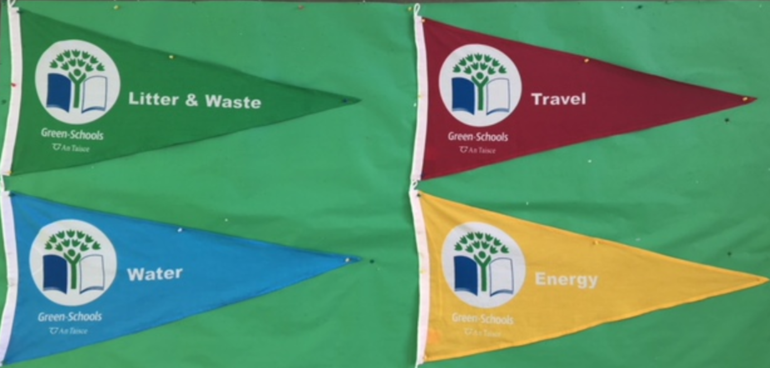
Green Schools Programme – Flags to date
Litter and Waste
Energy
Water
Travel
Biodiversity – working on it this year.

Slide 9

Little Acorns
Our ASD pre-school class caters for children aged 3 to 5 and offers the interventions they require before they begin school.

Slide 10
B.L.A.S.T (Bringing Live Arts to Students and Teachers )
It’s a new innovative Arts – in – Education Residency Programme enabling schools to gain support and integration in the area of the Arts.
The aim of the scheme is to give pupils in schools all over the country the opportunity to work with a professional artist on unique projects.
4th Class have been working with a professional sculptor (Penelope Monaghan) who has spent days with the children and Ms.Kearns in the classroom and on fieldtrips taking them on a creative journey using different forms of clay.
They will feature in the Solstice on the 31st of May as a pop-up exhibition to showcase their work.
This year our 6th. Class worked with artist Ciaran Byrne on creating the soundtrack to a horror movie.

Slide 11
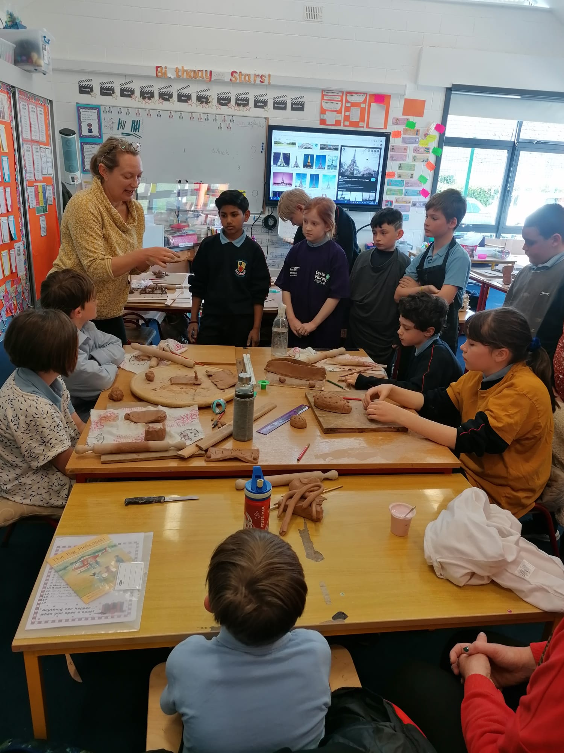
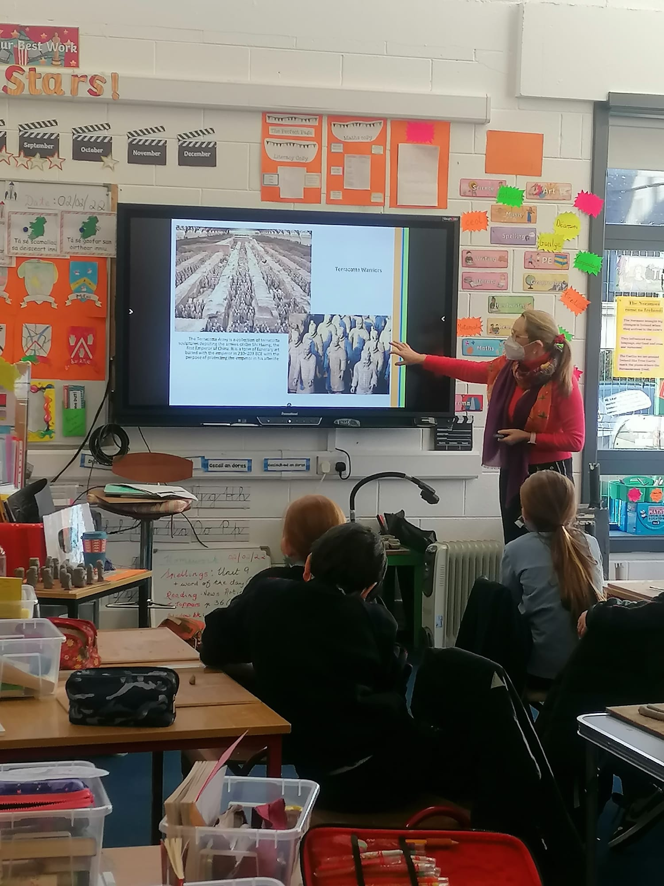

Slide 12
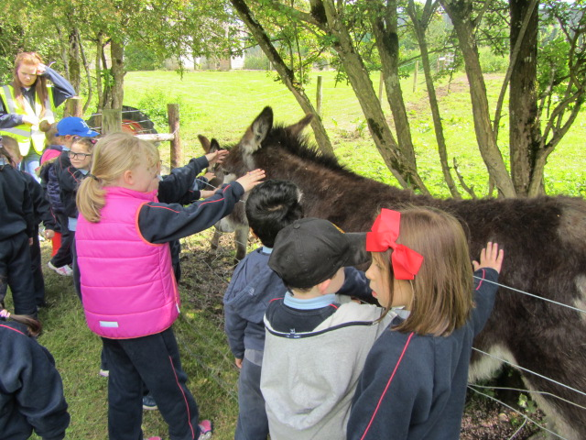
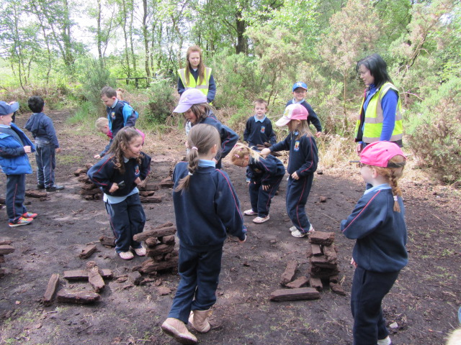
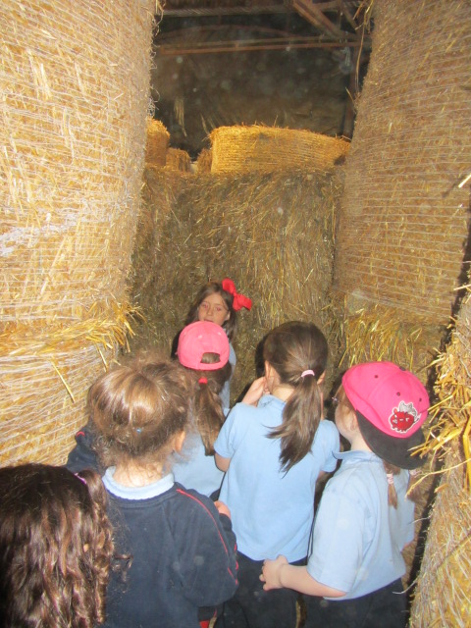
School Tours
- Educational tours: Library / Solstice / Museums / Historical Sites / places of interest.

Slide 13
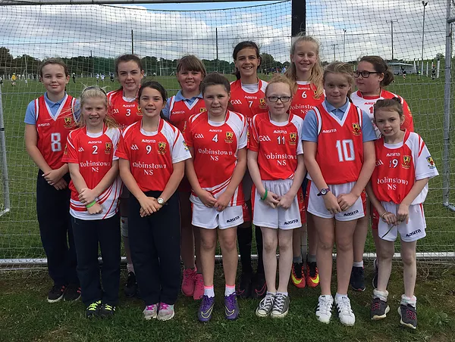
Rounders

Slide 14
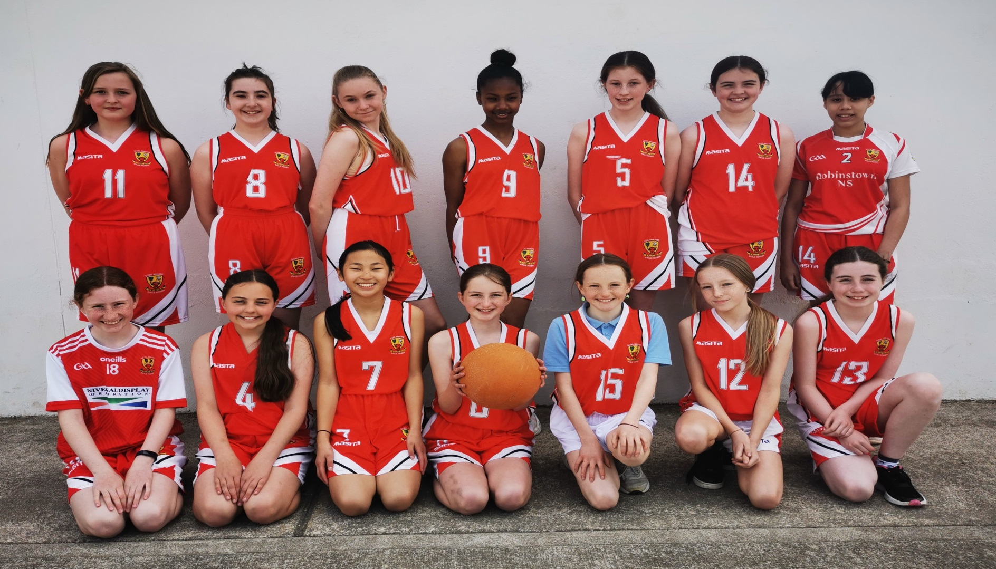
Basketball

Slide 15
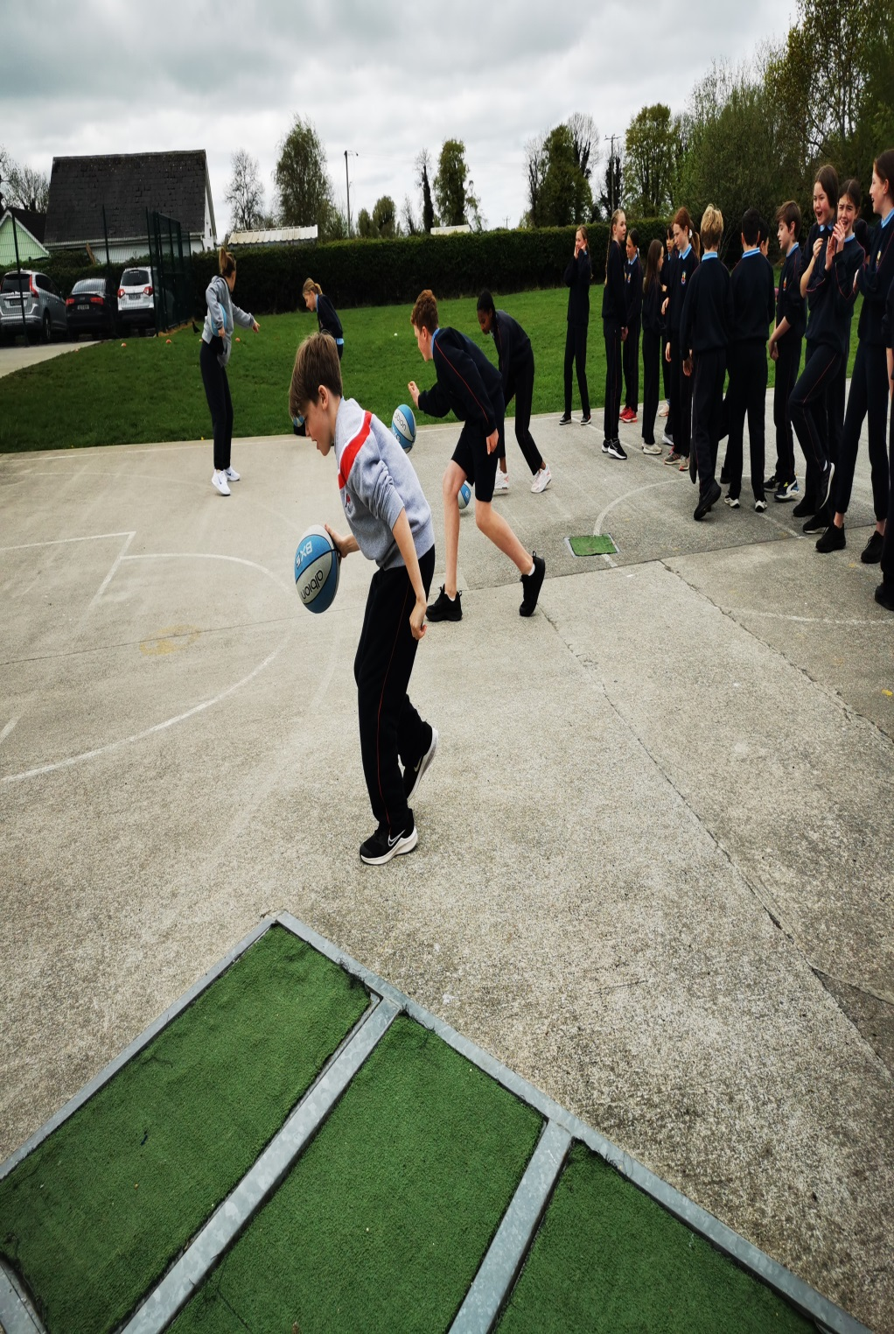
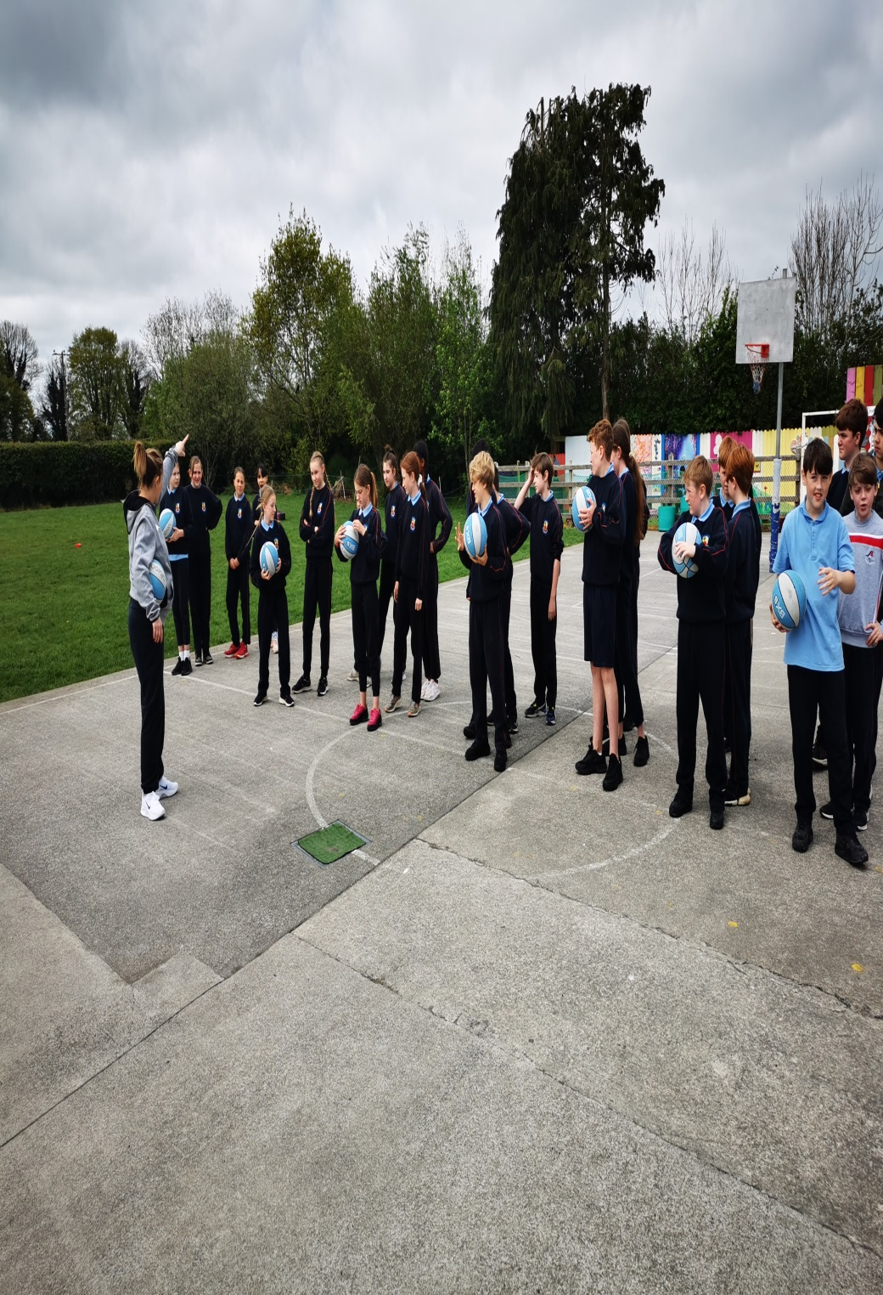

Slide 16
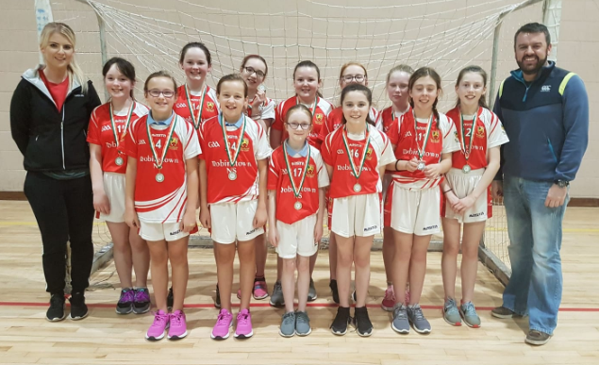
Handball

Slide 17
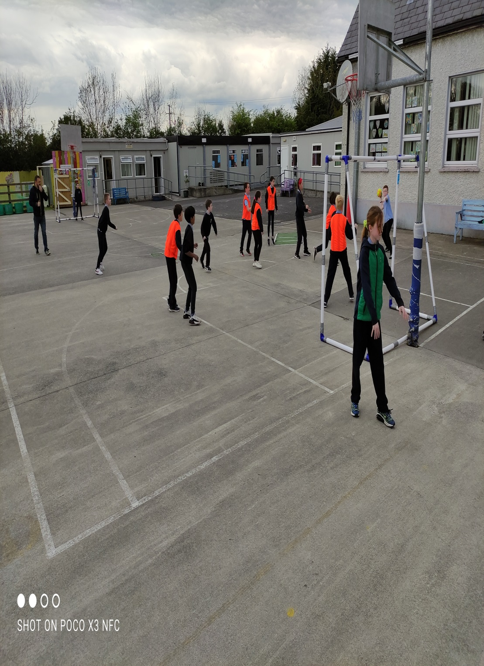
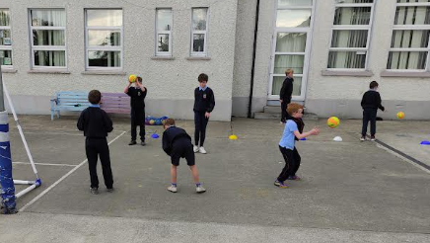

Slide 18
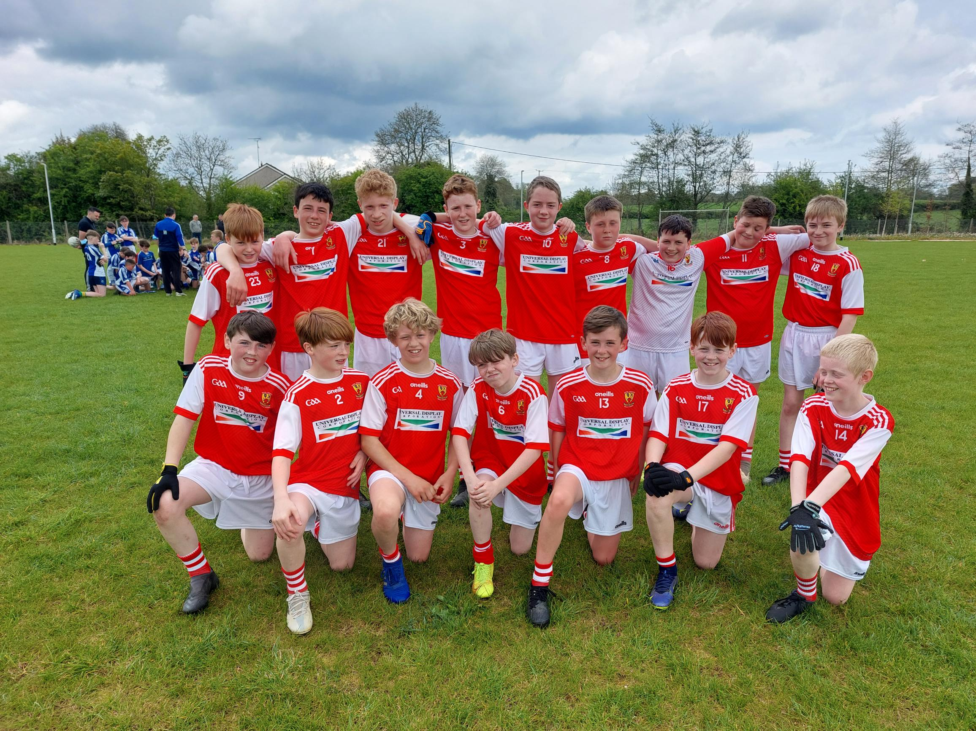
Gaelic Football

Slide 19
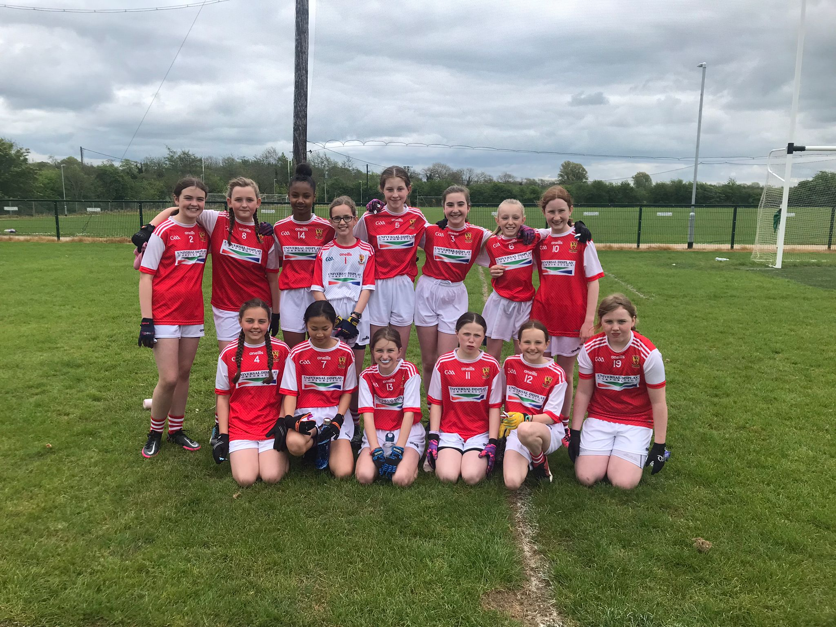

Slide 20
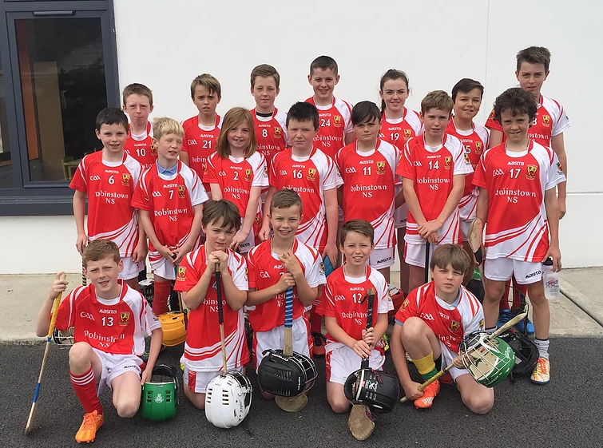
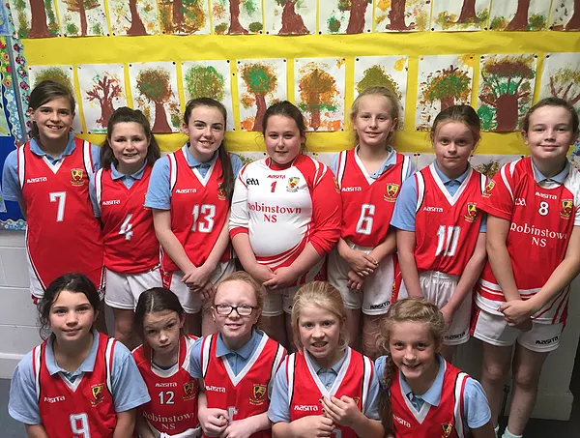
Hurling/ Camogie

Slide 21
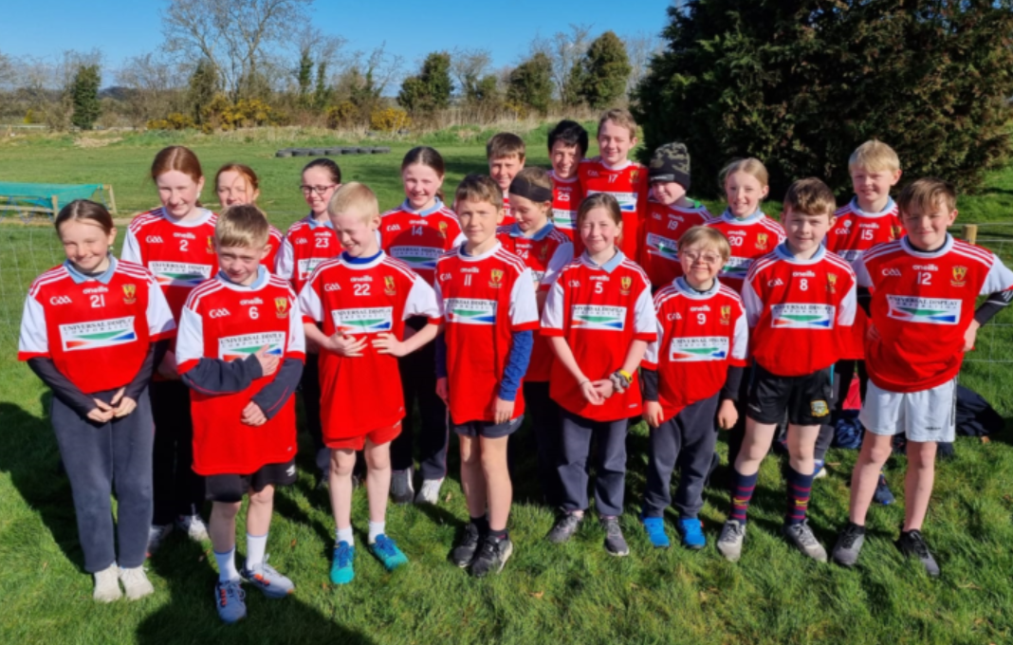
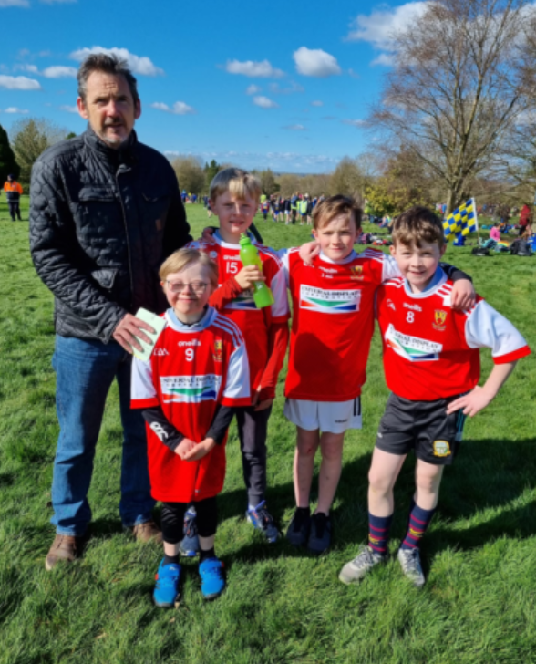
Athletics

Slide 22

IT
We have access to 30 laptops and 35 tablets in Robinstown NS. These are timetabled for all classes.
We follow an IT framework:
e.g. 1st class – start a programme, work on text and pictures.
3rd Will focus on typing using the BBC dance mat typing programme.
4th Class will work on files and folders and how to organise and save work. Focus will also be on typing using the TTRS typing programme.
6th Class will work on how to develop their own website.
Digital learning is an integral part of the new curriculum which will be implemented in 2025

Slide 23
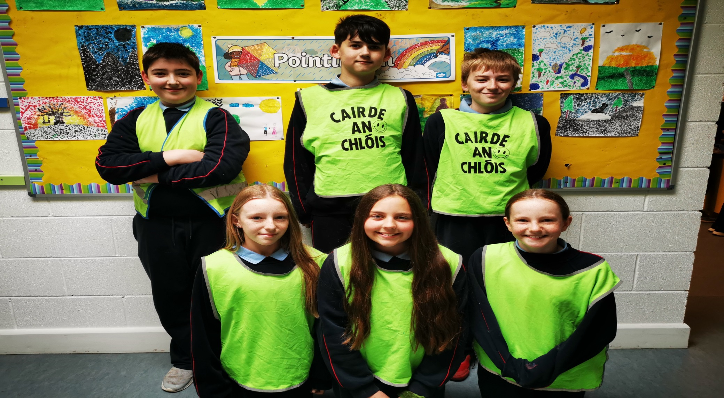
Cairde an Chlóis

Slide 24
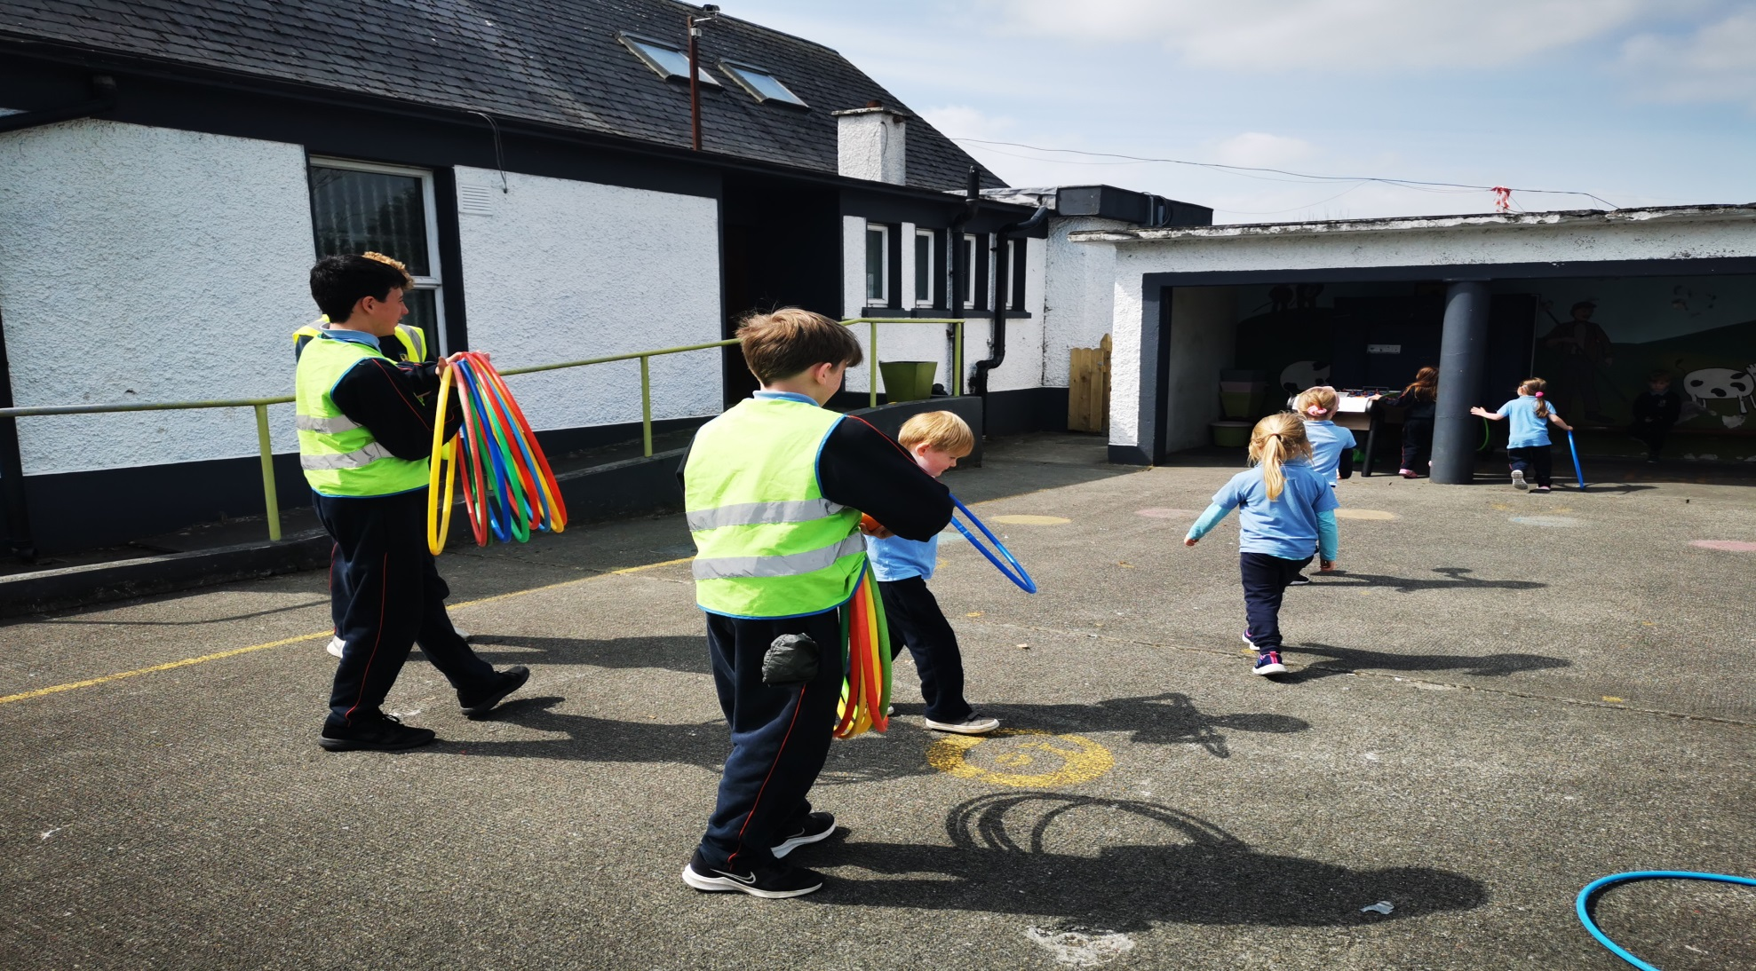
Cairde an Chlóis

Slide 25
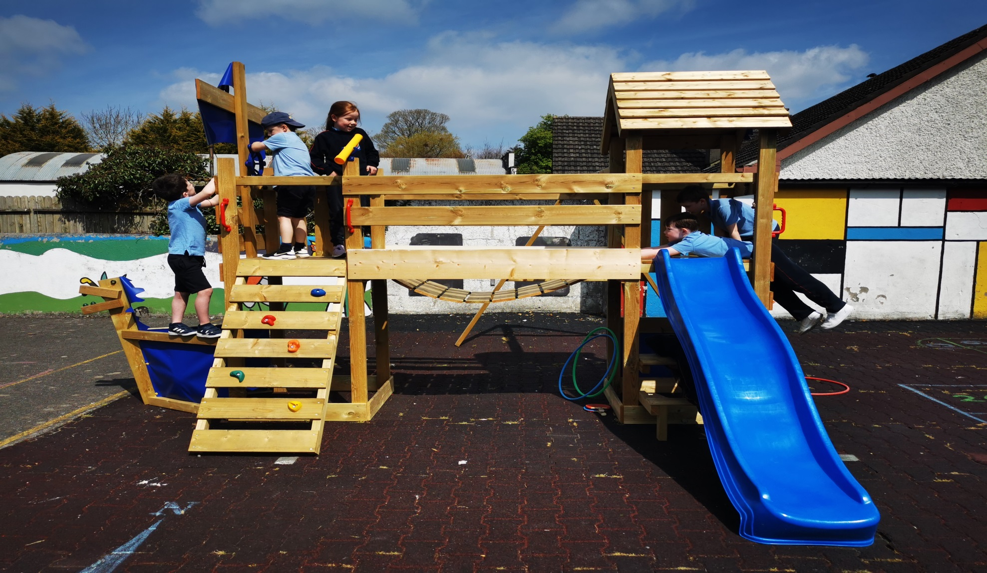
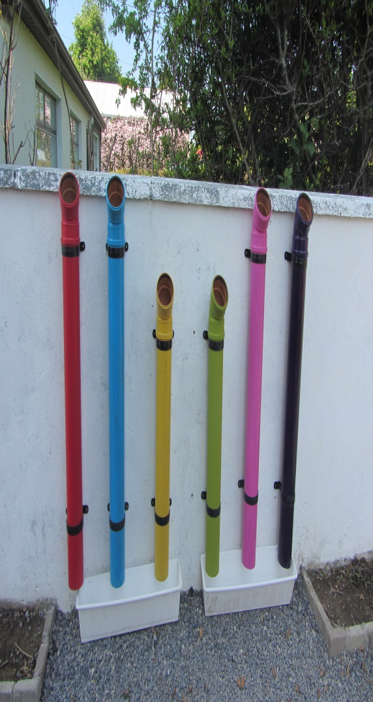
Infant Yard

Slide 26
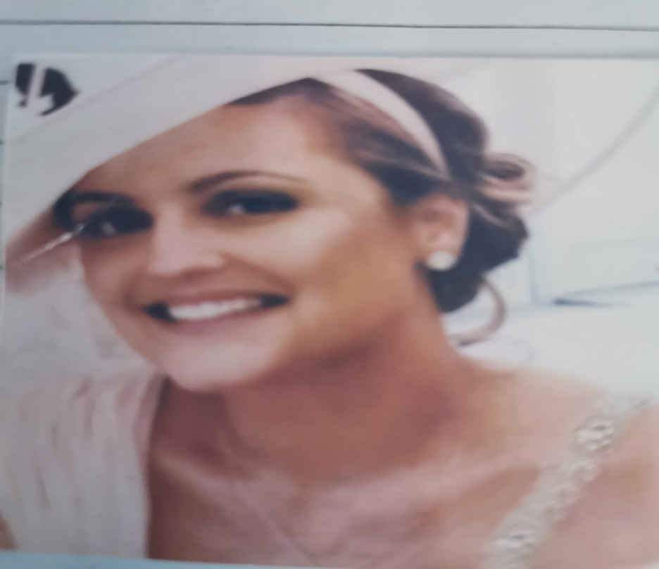
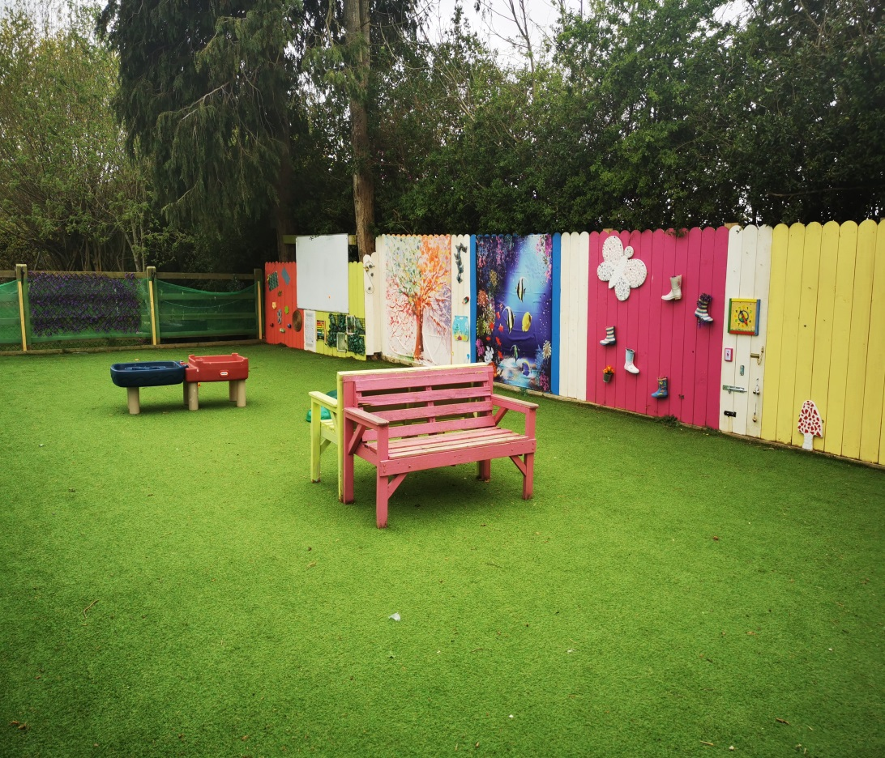
Ms. Brady’s Outdoor Classroom / Sensory Garden
Ms. Brady was a member of our teaching staff who sadly passed away in 2016. This part of our school garden was opened in her memory. Little Acorns use it at break times and all other classes have access during the school day.

Slide 27
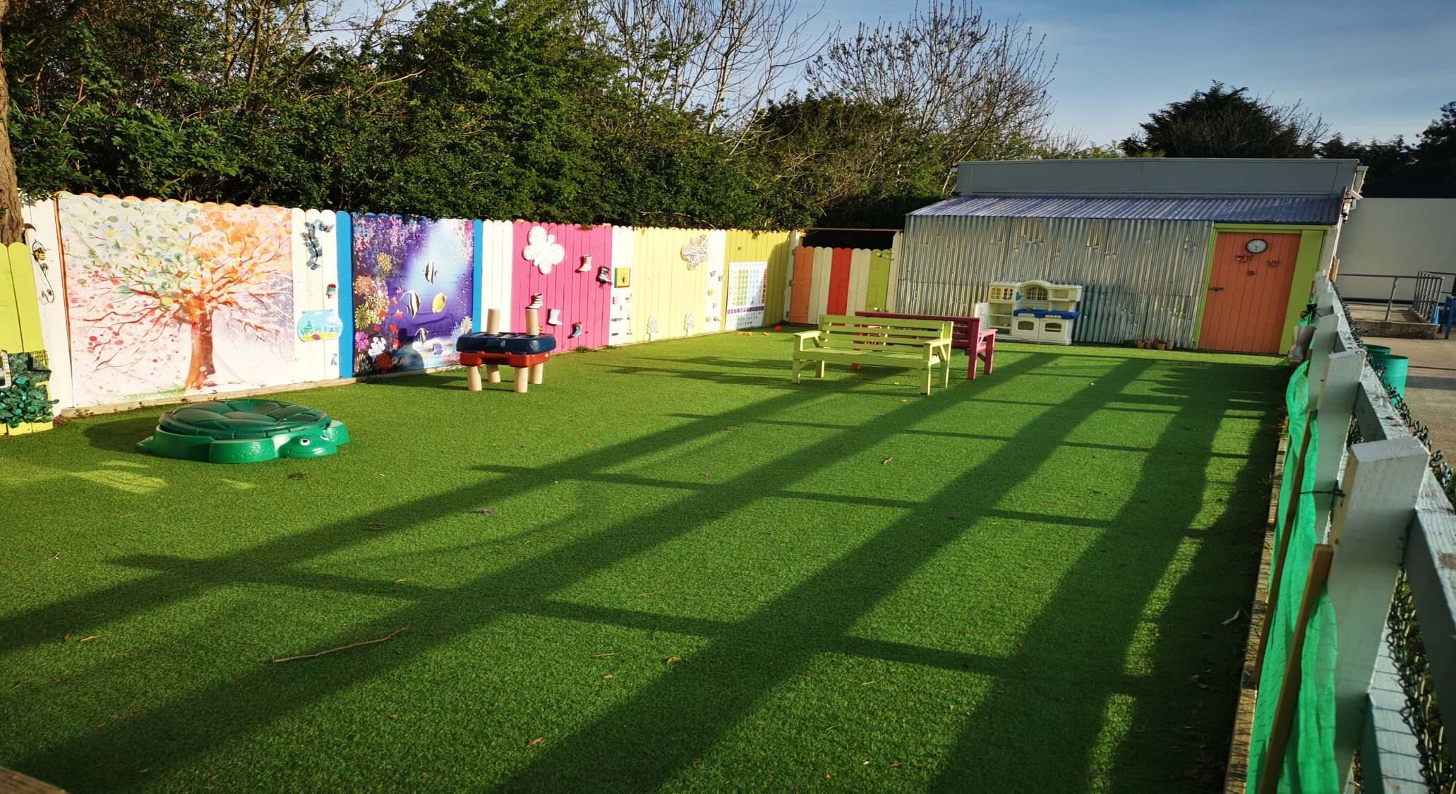
Outdoor Classroom and Ms.Brady’s Classroom

Slide 28
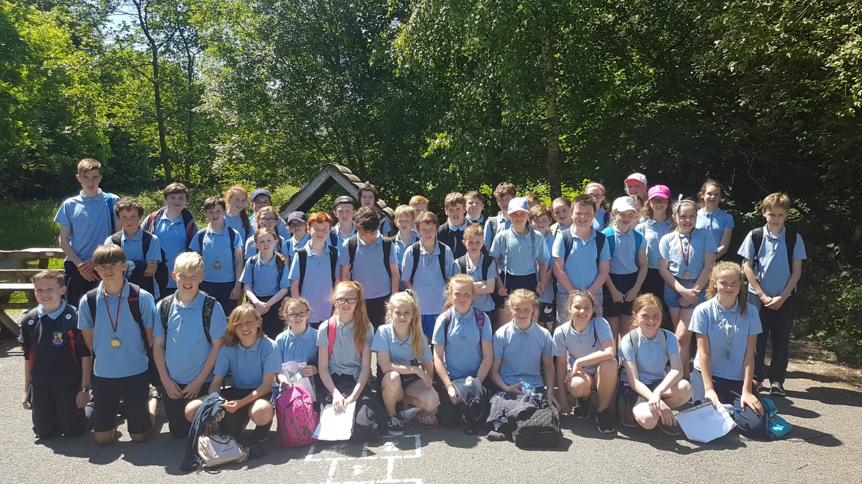
Orienteering
5th and 6th Class in Balrath Woods.

Slide 29
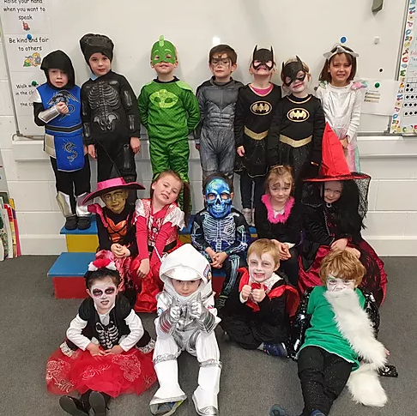
Halloween Fancy Dress

Slide 30
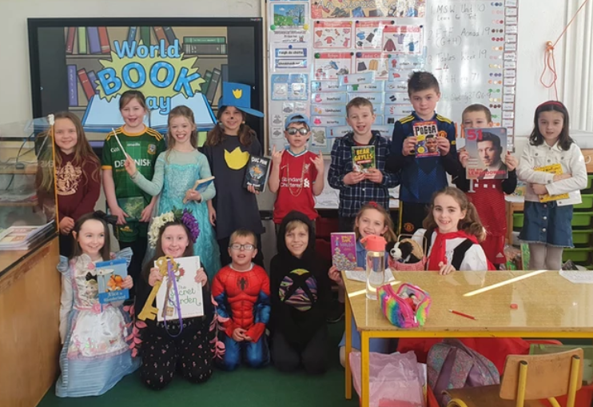
World Book Day Fancy Dress

Slide 31
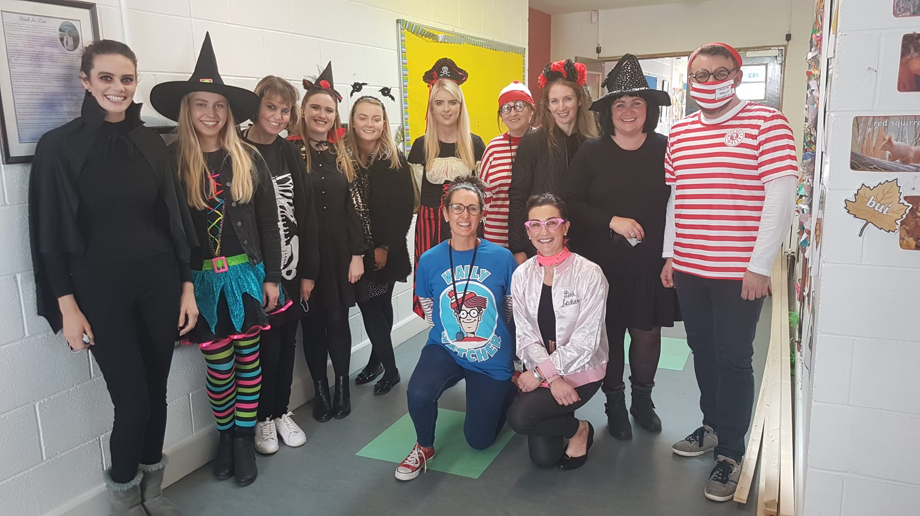
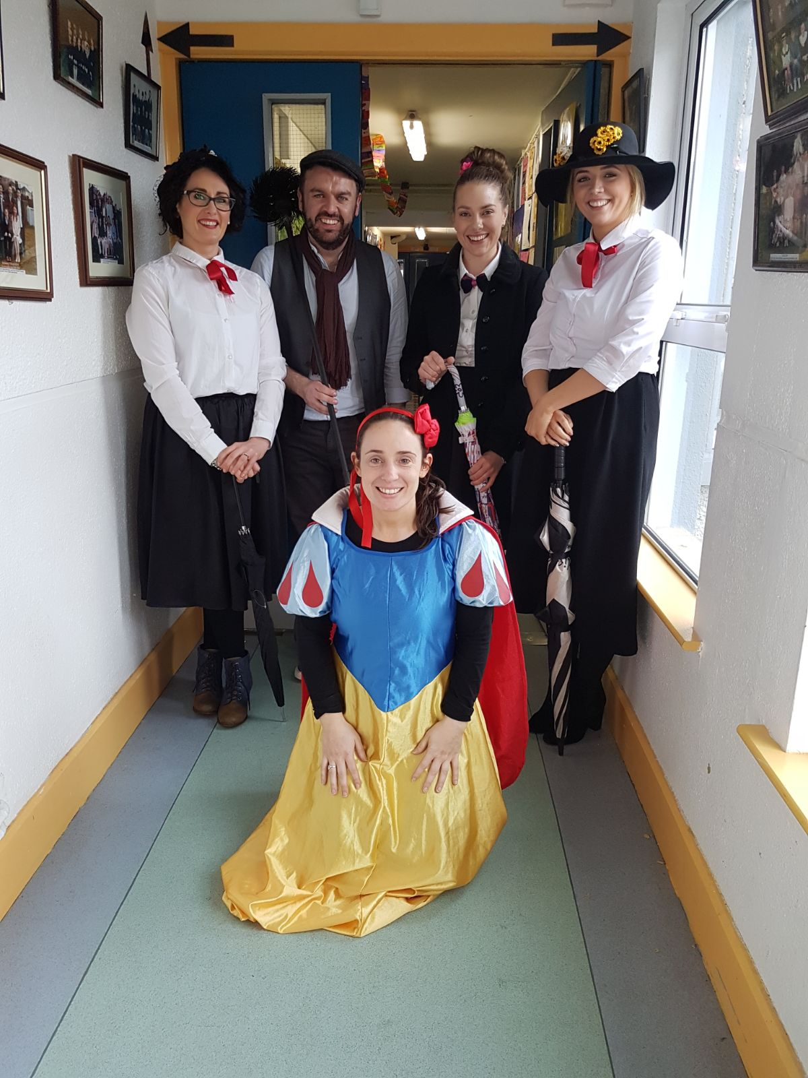
Fancy Dress

Slide 32
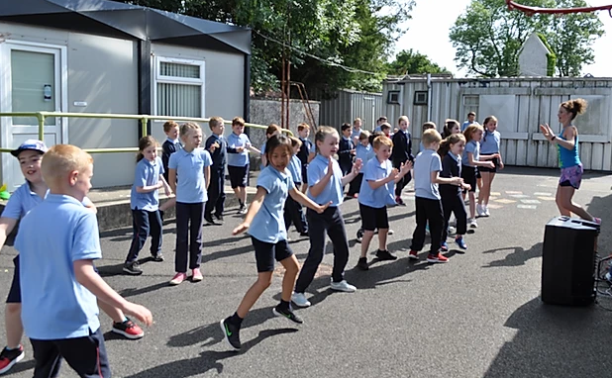
Active School Week

Slide 33
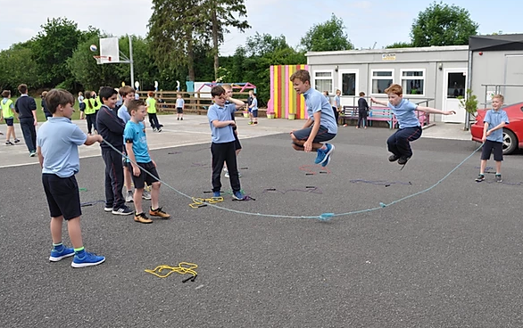
Active School Week

Slide 34
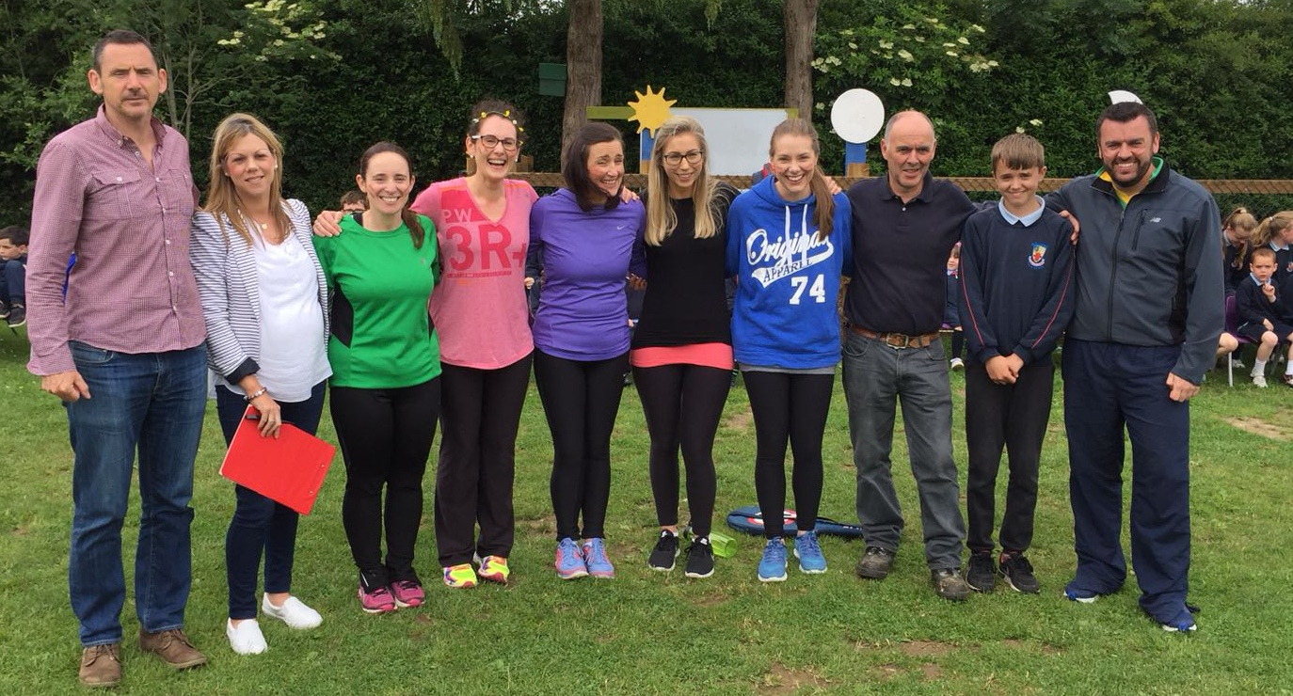
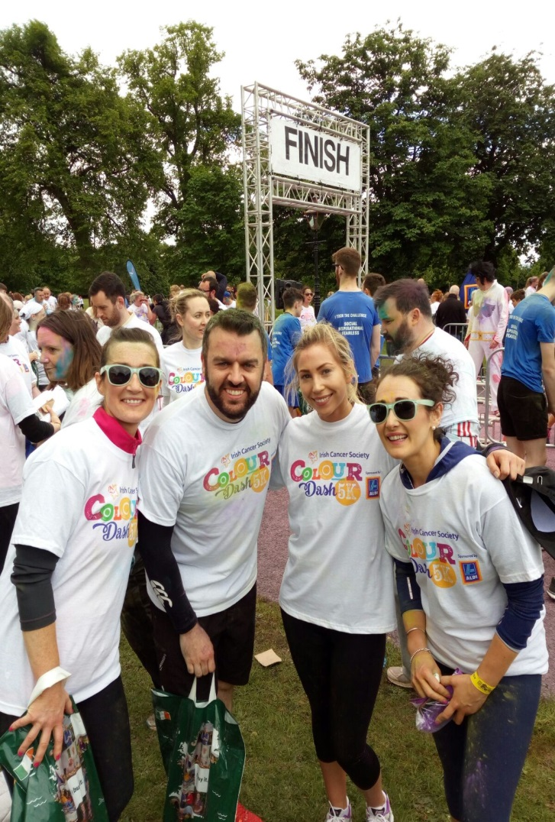
End of year activities

Slide 35
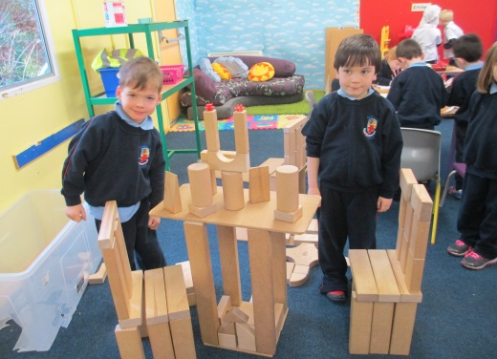
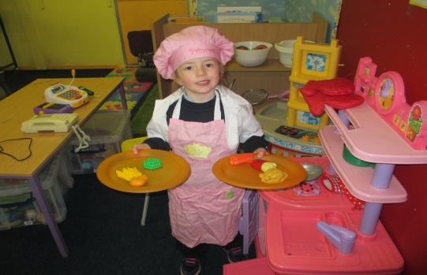
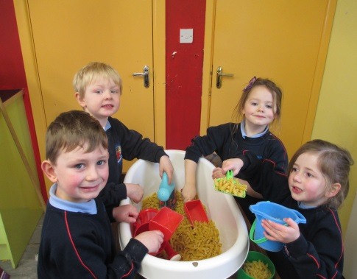
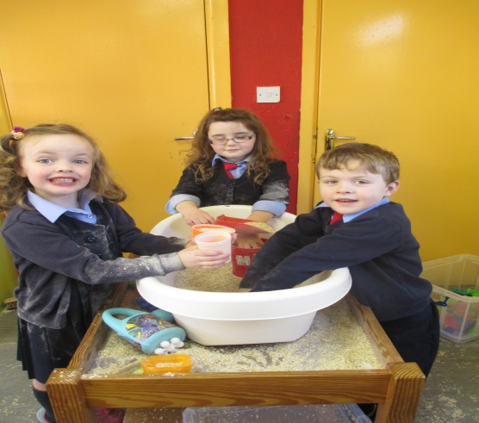
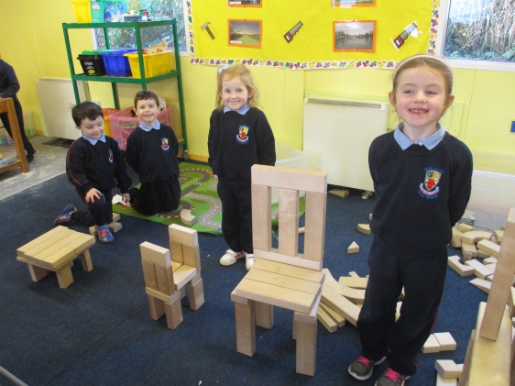
Aistear
Aistear is the early childhood curriculum framework for children in Junior and Senior Infants
Teacher facilitates children in leading their own learning
Themes include Well-being, Identity and Belonging, Communicating, Exploring and Thinking

Slide 36
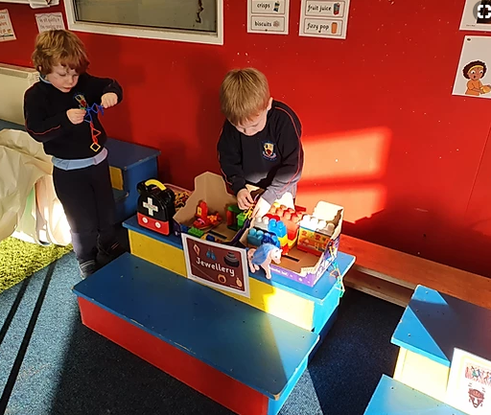
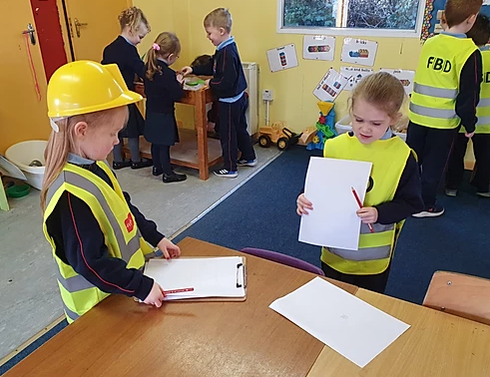
Aistear

Slide 37

Aistear
The theme for this particular month is ‘Summer’

Slide 38
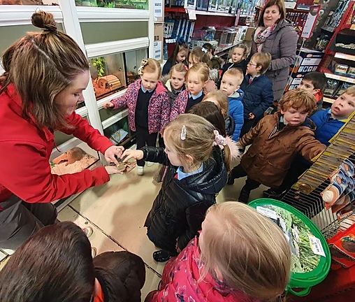
Aistear
The theme for this month was ‘The Vet’ .
The children got to visit the pet store , meet lots of the animals and learn all about them.
They even got to take home a class pet goldfish.

Slide 39
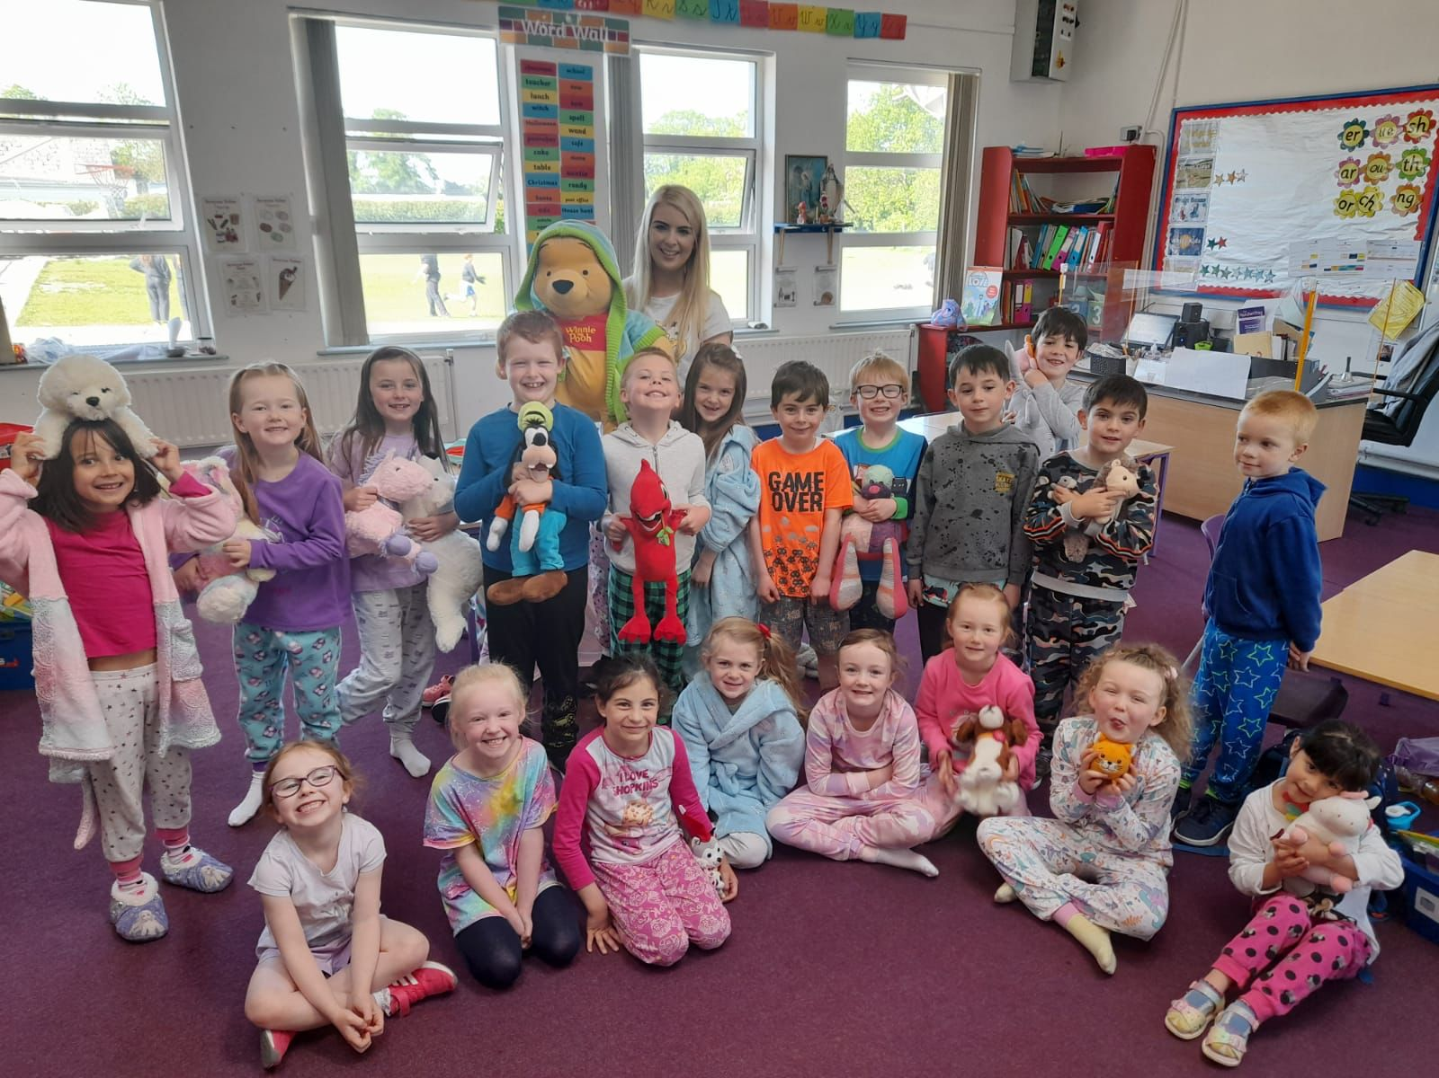
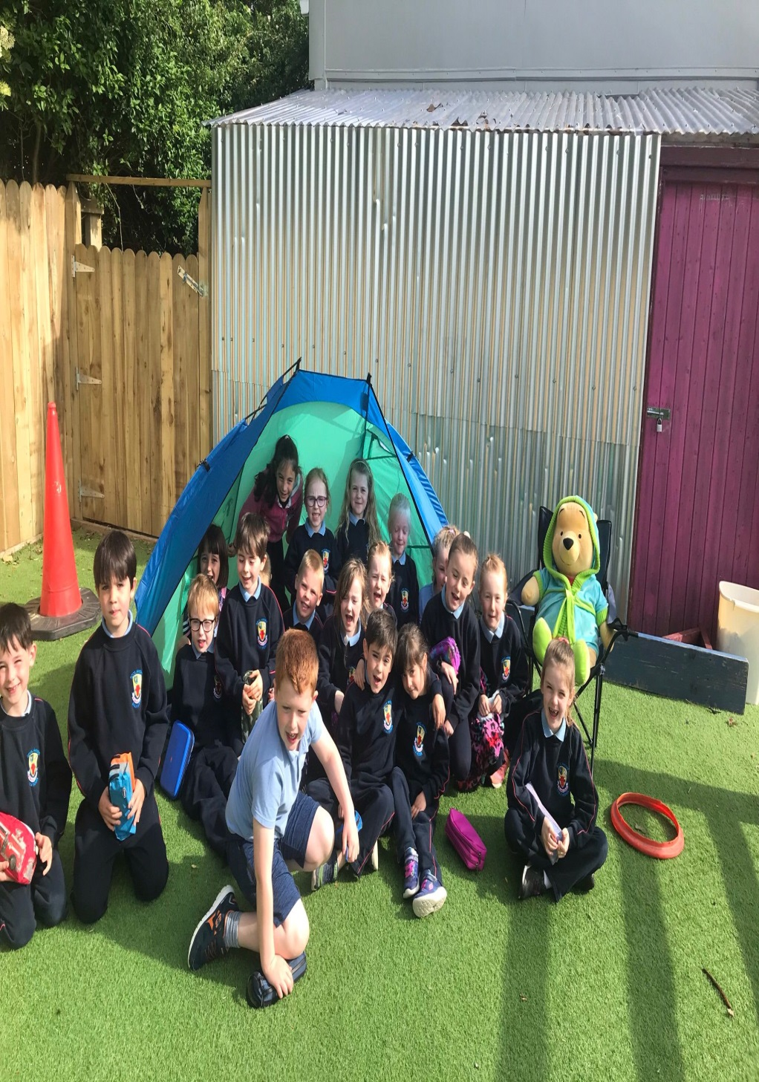

Slide 40
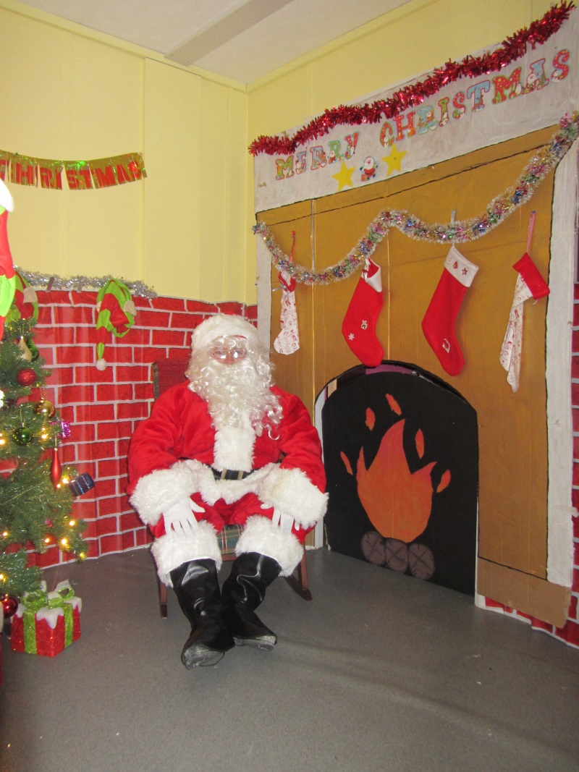
Santa’s Visit
Santa visits the boys and girls in Junior and Senior Infants every Christmas. It’s always a secret so hush, hush!!!

Slide 41
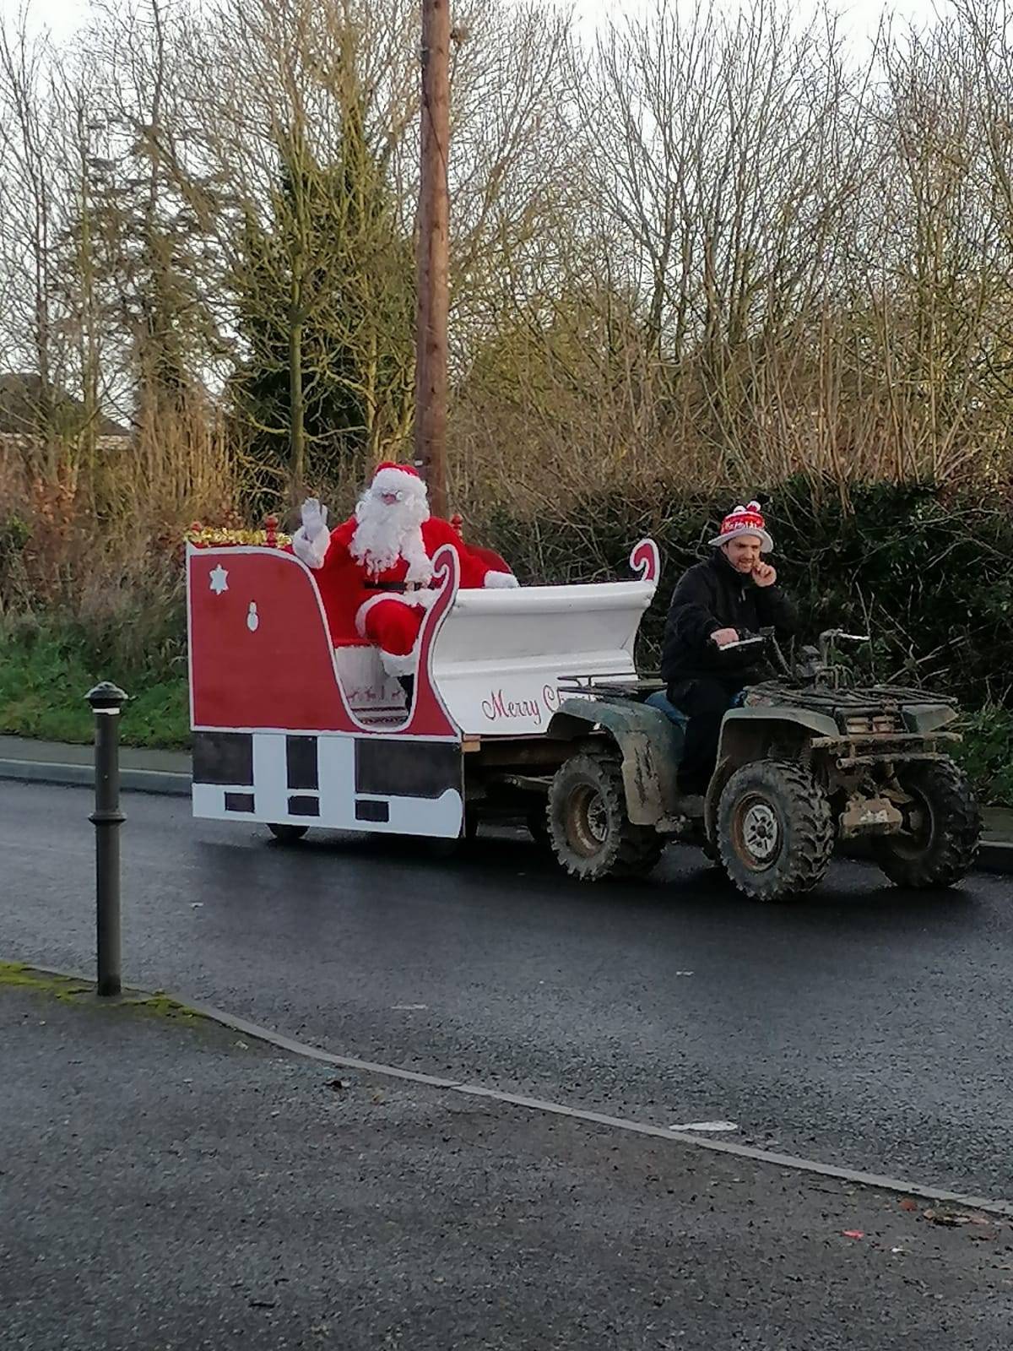
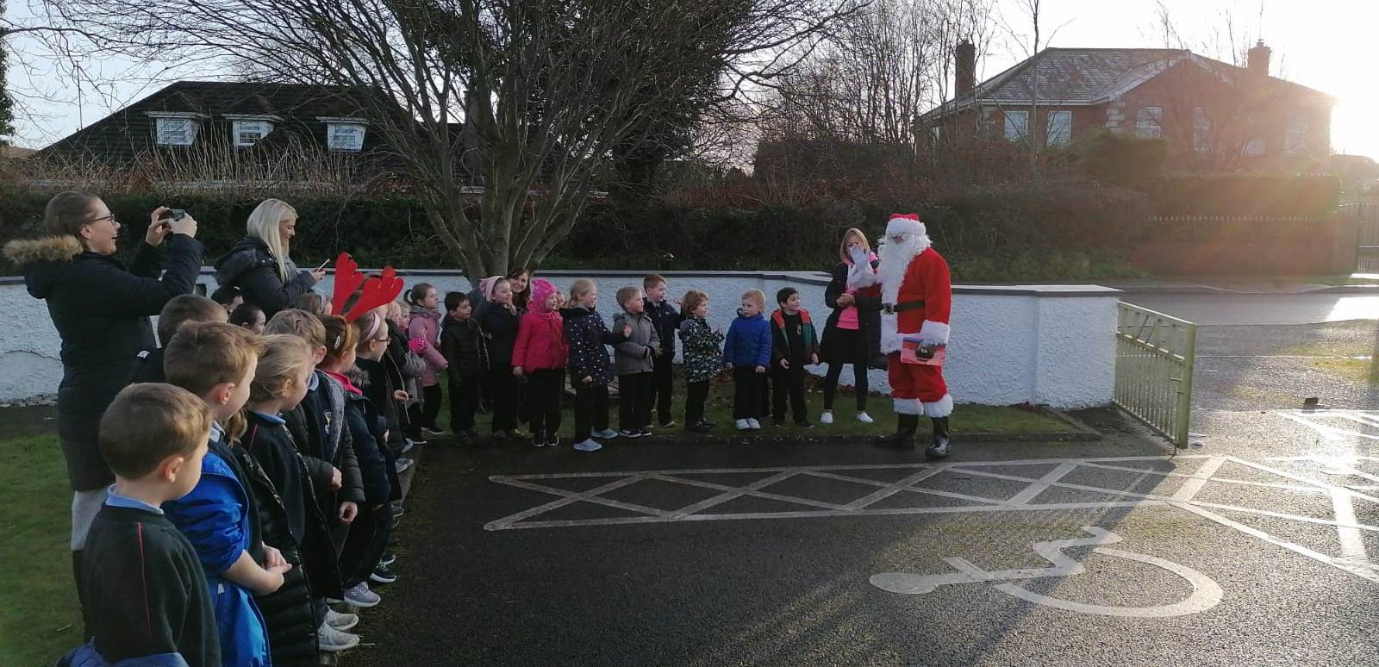
Santa’s Visit

Slide 42
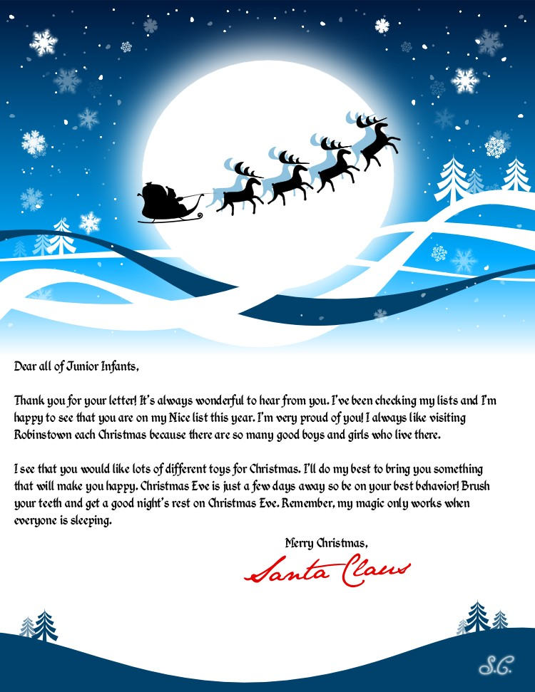

Slide 43
Before Your Child Starts
The independence of your child is crucial in making the transition to school as smooth and enjoyable as possible
Button and unbutton a coat and hang it up
Encourage personal hygiene and cleanliness. Your child should know how to flush the toilet and wash hands , without having to be told.
Share toys and playthings with others and ‘take turns.’
Tidy up and put away playthings.

Slide 44

Before Your Child Starts

Slide 45
First Day At School.
For the first two weeks the Junior Infants will start at 8.50am and finish at 12 o’clock.
For the first day bring your child into the classroom, they will be welcomed and shown to their seat.
Having given assurance you will be back to collect him/her, wave goodbye and make your getaway without delay.
The children will be brought to the front door at home time. Please wait there.
For the first week you can drop them at the classroom door. On the second week you will bring your child to the Junior Infant line in the yard. The teacher will bring the class in from here.

Slide 46

First Day at School
In spite of the best efforts of both teacher and parents/guardians a small number of children may still become upset. If your child happens to be one of them don’t panic. Patience, perseverance and consistency can work wonders.

Slide 47
Do.......................................
Label everything, including all your child’s uniform and tracksuit with a permanent pen/marker.
Give your child jobs to do at home and build them up over time.
Buy big school bags with no wheels and make sure they are large enough to hold A4 folders.
Drinks bottles and lunch boxes that are sturdy but easy to open.
Buy runners with velcro.
They should have a coat that they can easily manage.
Give out birthday invitations at the school gate.

Slide 48
School Books
All school books, activity books and copies will be provided by the school for Sept 2023.
This will lessen the costs for parents as their child begins their journey through primary school.
It will also reduce stress levels for parents and children as they will not have to worry about whether they have all the right books.
Miss Kearns will let you know over the next couple of weeks which items you may have to purchase for Sept. 2023.

Slide 49


Healthy Eating
We promote healthy eating in Robinstown NS.
Research indicates a strong link between diet and performance in school.
Lunch is an important meal for school going children, so we encourage all parents to put thought and care into preparing lunches.
Please see school website for our Healthy Eating Policy. These guidelines were drawn up by school staff, parents and pupils of Robinstown NS.

Slide 50
Lunches
Children get time to eat their lunch before they go on yard (approximately 10 minutes)
Give them enough food they can manage (Practice at home)
Drinks container they can open and close themselves.
Zip lunch boxes work best
They must be able to recognise their own lunch box and container
The Lunch Bag deliver lunch to the school each day through their app. Parents can register and choose items for their child’s lunch.
Play in Junior Infant yard which is fully supervised
Please note that we are a NUT FREE school.

Slide 51


The Lunch Bag

Slide 52
Homework
Homework will be in folder marked homework.
Will need your guidance, supervision and signature.
Notes may also be in this folder.
We use Jolly Phonics, every night you will need to practise the sounds and songs.

Slide 53

Literacy
We use the Jolly Phonics programme which teaches children to read and write from an early age.
Teaching is multi-sensory and active, with fun actions, stories and songs. It teaches letter sounds as opposed to the alphabet.
Learning the letter sounds
Learning letter formation
Blending
Segmenting
Tricky words

Slide 54

Schedule of Intervention

Slide 55
Numeracy – Ready, Set, Go - Maths
Ready Set Go Maths is a hands-on approach to learning mathematical concepts in Junior and Senior Infants. It is designed to enable children to develop and consolidate their understanding of numbers through activities and interactive games.
The Key message behind the programme is that children are engaged in active learning and there is an emphasis on the use of language to explain our mathematical thinking, what we are doing and why we are doing it. Ready, Set, Go Maths focuses on 4 main areas:
Sorting
Relationships and Operations
Counting and Recognition
Understanding Numbers.
Classroom teacher and teachers from our Learning Support Team, work with the pupils in the class in smaller groups. Children work at a ‘station’, usually doing three to four activities each day. Activities generally involve working with concrete materials and playing games.

Slide 56



Slide 57



Slide 58
Helpful Activities/Tips……
Join the local library and read to your child
Plant something in the ground
Routine and lots of sleep
Exercise is very important
Manners will take you everywhere!

Slide 59

Please see our school website for more information and tips for parents.
https://www.robinstownns.com

Slide 60
Little Robins
Our local childcare facility was opened in January 2017. It opens daily from 8am. Children attending after school care in Little Robins are collected at school by member of Little Robins staff.
Services include:
Breakfast club
Pre school
After school, meals included in the cost
Part day care
Full day care
Guitar lessons (age 7)

Slide 61
We look forward to welcoming the children to the school on Wednesday 7th of June from 1pm – 2pm.
The pupils will play and socialise in the classroom, meet their new classmates and teacher. Parents will be offered refreshments and the opportunity to ask questions.

Slide 62

Thank you for coming

